Slide 1
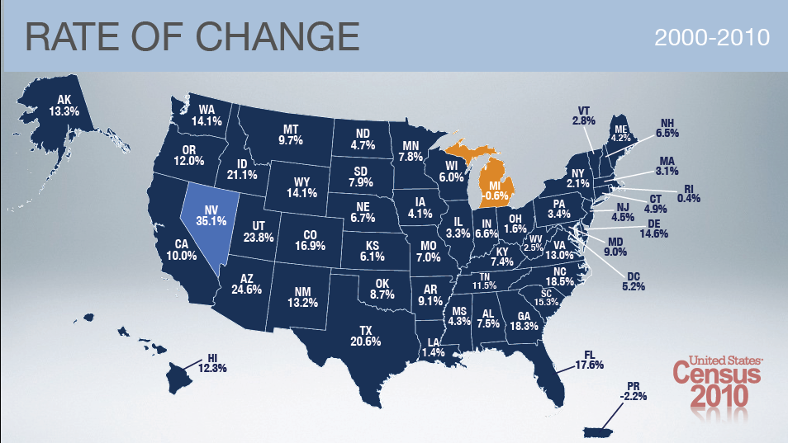
Demographic Trends in the West
Department of Business, Economic Development & Tourism
Honolulu, Hawaii
August 2, 2011
Jerry Wong
U.S. Census Bureau

Slide 2
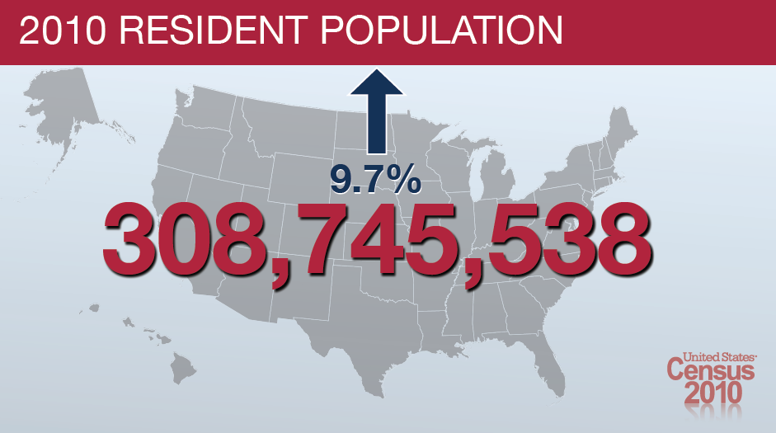

Slide 3
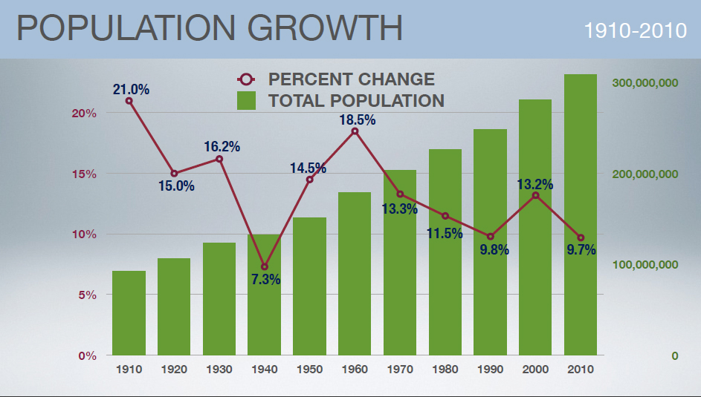

Slide 4
Population Growth in the West

Slide 5
Population Growth Western States
State | 2000 | 2010 | Numeric Change | % Change
West | 63,197,932 | 71,945,553 | 8,747,621 | 13.8%
Alaska | 626,932 | 710,231 | 83,299 | 13.3%
Arizona | 5,130,632 | 6,392,017 | 1,261,385 | 24.6%
California | 33,871,648 | 37,253,956 | 3,382,308 | 10.0%
Colorado | 4,301,261 | 5,029,196 | 727,935 | 16.9%
Hawaii | 1,211,537 | 1,360,301 | 148,764 | 12.3%
Idaho | 1,293,953 | 1,567,582 | 273,629 | 21.1%
Montana | 902,195 | 989,415 | 87,220 | 9.7%
Nevada | 1,998,257 | 2,700,551 | 702,294 | 35.1%
New Mexico | 1,819,046 | 2,059,179 | 240,133 | 13.2%
Oregon | 3,421,399 | 3,831,074 | 409,675 | 12.0%
Utah | 2,233,169 | 2,763,885 | 530,716 | 23.8%
Washington | 5,894,121 | 6,724,540 | 830,419 | 14.1%
Wyoming | 493,782 | 563,626 | 69,844 | 14.1%

Slide 6
Notes:
California’s First Census in 1850: 92,597
Gained seats in every census until 2010.

Slide 7
Population Growth for States by Decade

Slide 8
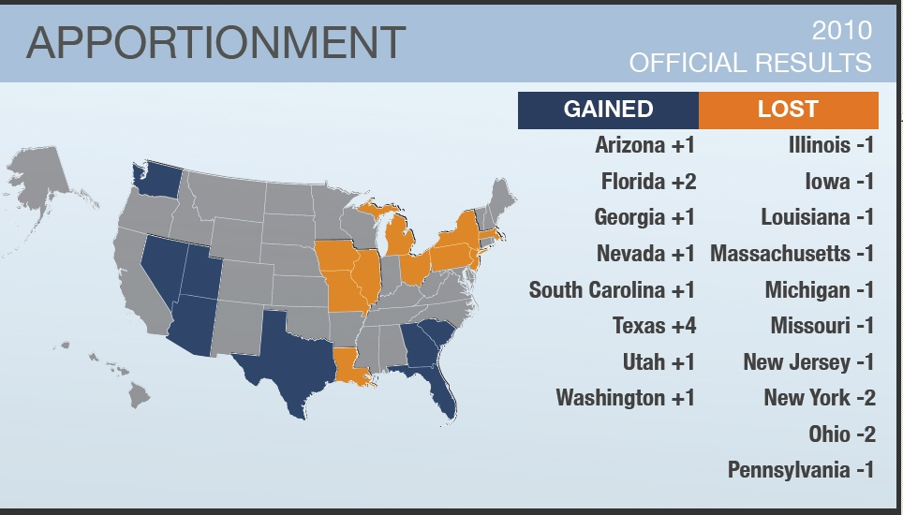

Slide 9
94 Representatives from the West

Slide 10
County Population
The most populous county in the nation is located in the West
11 of the top 25 counties are in the West
The West contains 26 of the nation’s top 100 most populous counties.

Slide 11
Top Counties
Rank | County | Population
1 | Los Angeles County, CA | 9,818,605
4 | Maricopa County, AZ | 3,817,117
5 | San Diego, CA | 3,095,313
6 | Orange, CA | 3,010,232
11 | Riverside, CA | 2,189,641
12 | San Bernardino, CA | 2,035,210
13 | Clark County, NV | 1,951,269
14 | King County, WA | 1,931,249
17 | Santa Clara County, CA | 1,781,642
22 | Alameda County, CA | 1,510,271
25 | Sacramento County, CA | 1,418,788
37 | Contra Costa County, CA | 1,049,025
38 | Salt Lake County, UT | 1,029,655

Slide 12
Top Counties
Rank | County | Population
41 | Pima County, AZ | 980,263
43 | Honolulu County, HI | 953,207
46 | Fresno County, CA | 930,450
62 | Kern County, CA | 839,631
63 | Ventura County, CA | 823,318
66 | San Francisco County, CA | 805,235
72 | Pierce County, WA | 795,225
79 | Multnomah County, OR | 735,334
82 | San Mateo County, CA | 718,451
83 | Snohomish County, WA | 713,335
87 | San Joaquin County, CA | 685,306
92 | Bernalillo County, NM | 662,564
99 | El Paso County, CO | 622,263

Slide 13
Pop
Population Growth by County

Slide 14
City Population
The second most populous city in the nation is located in the West
16 of the nation’s top 50 cities are in the West
4 Western cities gained more than 100,000 people

Slide 15
Top Cities
Rank | City | Population
2 | Los Angeles, CA | 3,792,621
6 | Phoenix, AZ | 1,445,632
8 | San Diego, CA | 1,307,402
10 | San Jose, CA | 945,942
13 | San Francisco, CA | 805,235
26 | Denver, CO | 600,158
29 | Portland, OR | 583,776
30 | Las Vegas, NV | 583,756
32 | Albuquerque, NM | 545,852
33 | Tucson, AZ | 520,116
34 | Fresno, CA | 494,665
35 | Sacramento, CA | 466,488
36 | Long Beach, CA | 462,257
38 | Mesa, AZ | 439,041
41 | Colorado Springs, CO | 416,427
47 | Oakland, CA | 390,724

Slide 16
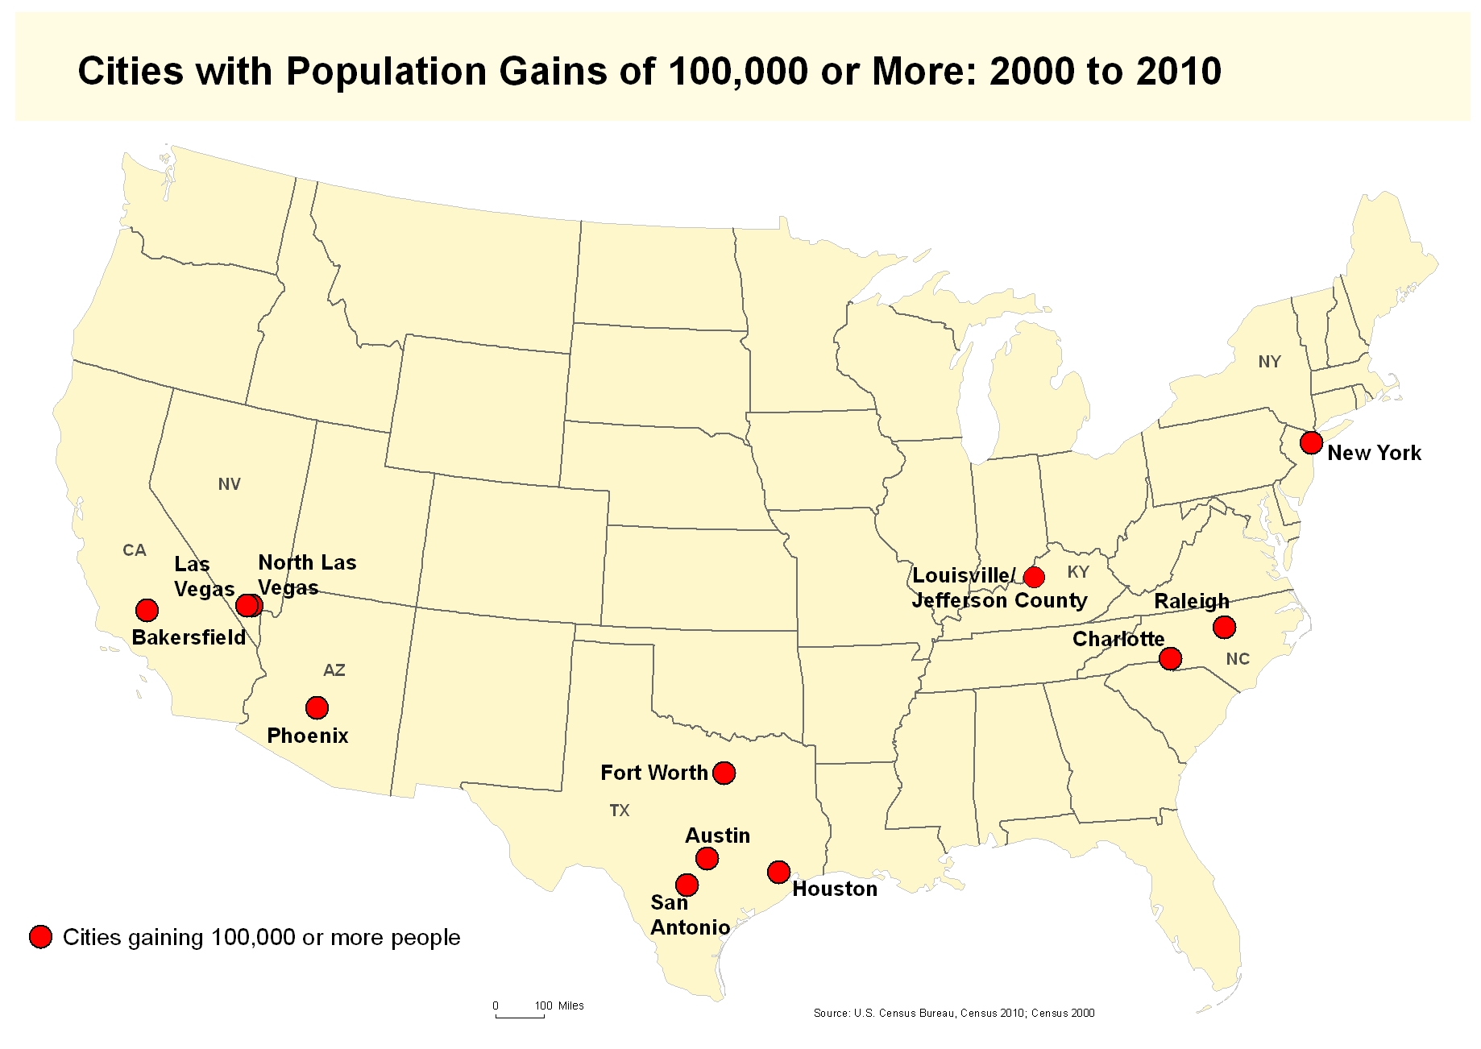

Slide 17
Age
1. Which city in the nation has the
highest median age?
Hint: The city is in the West
2. Which city in the nation has the
lowest median age?
Hint: The city is in the West

Slide 19
Age
Area | Population | Under 18 Years |  | 18 to 64 Years |  | 65 Years and Over |  | Median Age
 |  | Number | % | Number | % | Number | %
U.S. | 308,745,538 | 74,181,467 | 24.0 | 194,296,087 | 62.9 | 40,267,984 | 13.0 | 37.2
REGION
Northeast | 55,317,240 | 12,333,192 | 22.3 | 35,179,215 | 63.6 | 7,804,833 | 14.1 | 39.2
Midwest | 66,927,001 | 16,128,108 | 24.1 | 41,776,559 | 62.4 | 9,022,334 | 13.5 | 37.7
South | 114,555,744 | 27,788,757 | 24.3 | 71,873,002 | 62.8 | 14,893,985 | 13.0 | 37.0
West | 71,945,553 | 17,931,410 | 24.9 | 45,467,311 | 63.2 | 8,546,832 | 11.9 | 35.6

Slide 20
Median Age by State

Slide 21
Median Age for Western States
Years

Slide 22
Percent Under Age 18 Population Western States

Slide 23
Percent Older Population

Slide 24
Total Dependency Ratio
Total dependency ratio is
the number of children (0-17)
and older adults (ages 65 and
over) per 100 people of
working ages (ages 18-64) in
the state.

Slide 25
Diversity in the West
Total Minority Population
The West contains the largest concentration of minorities in the Nation— nearly 34 million.
They comprise 47% of the region, the highest percentage of all regions.
The West contains nearly 1/3 of the total minority population in the United States.

Slide 26
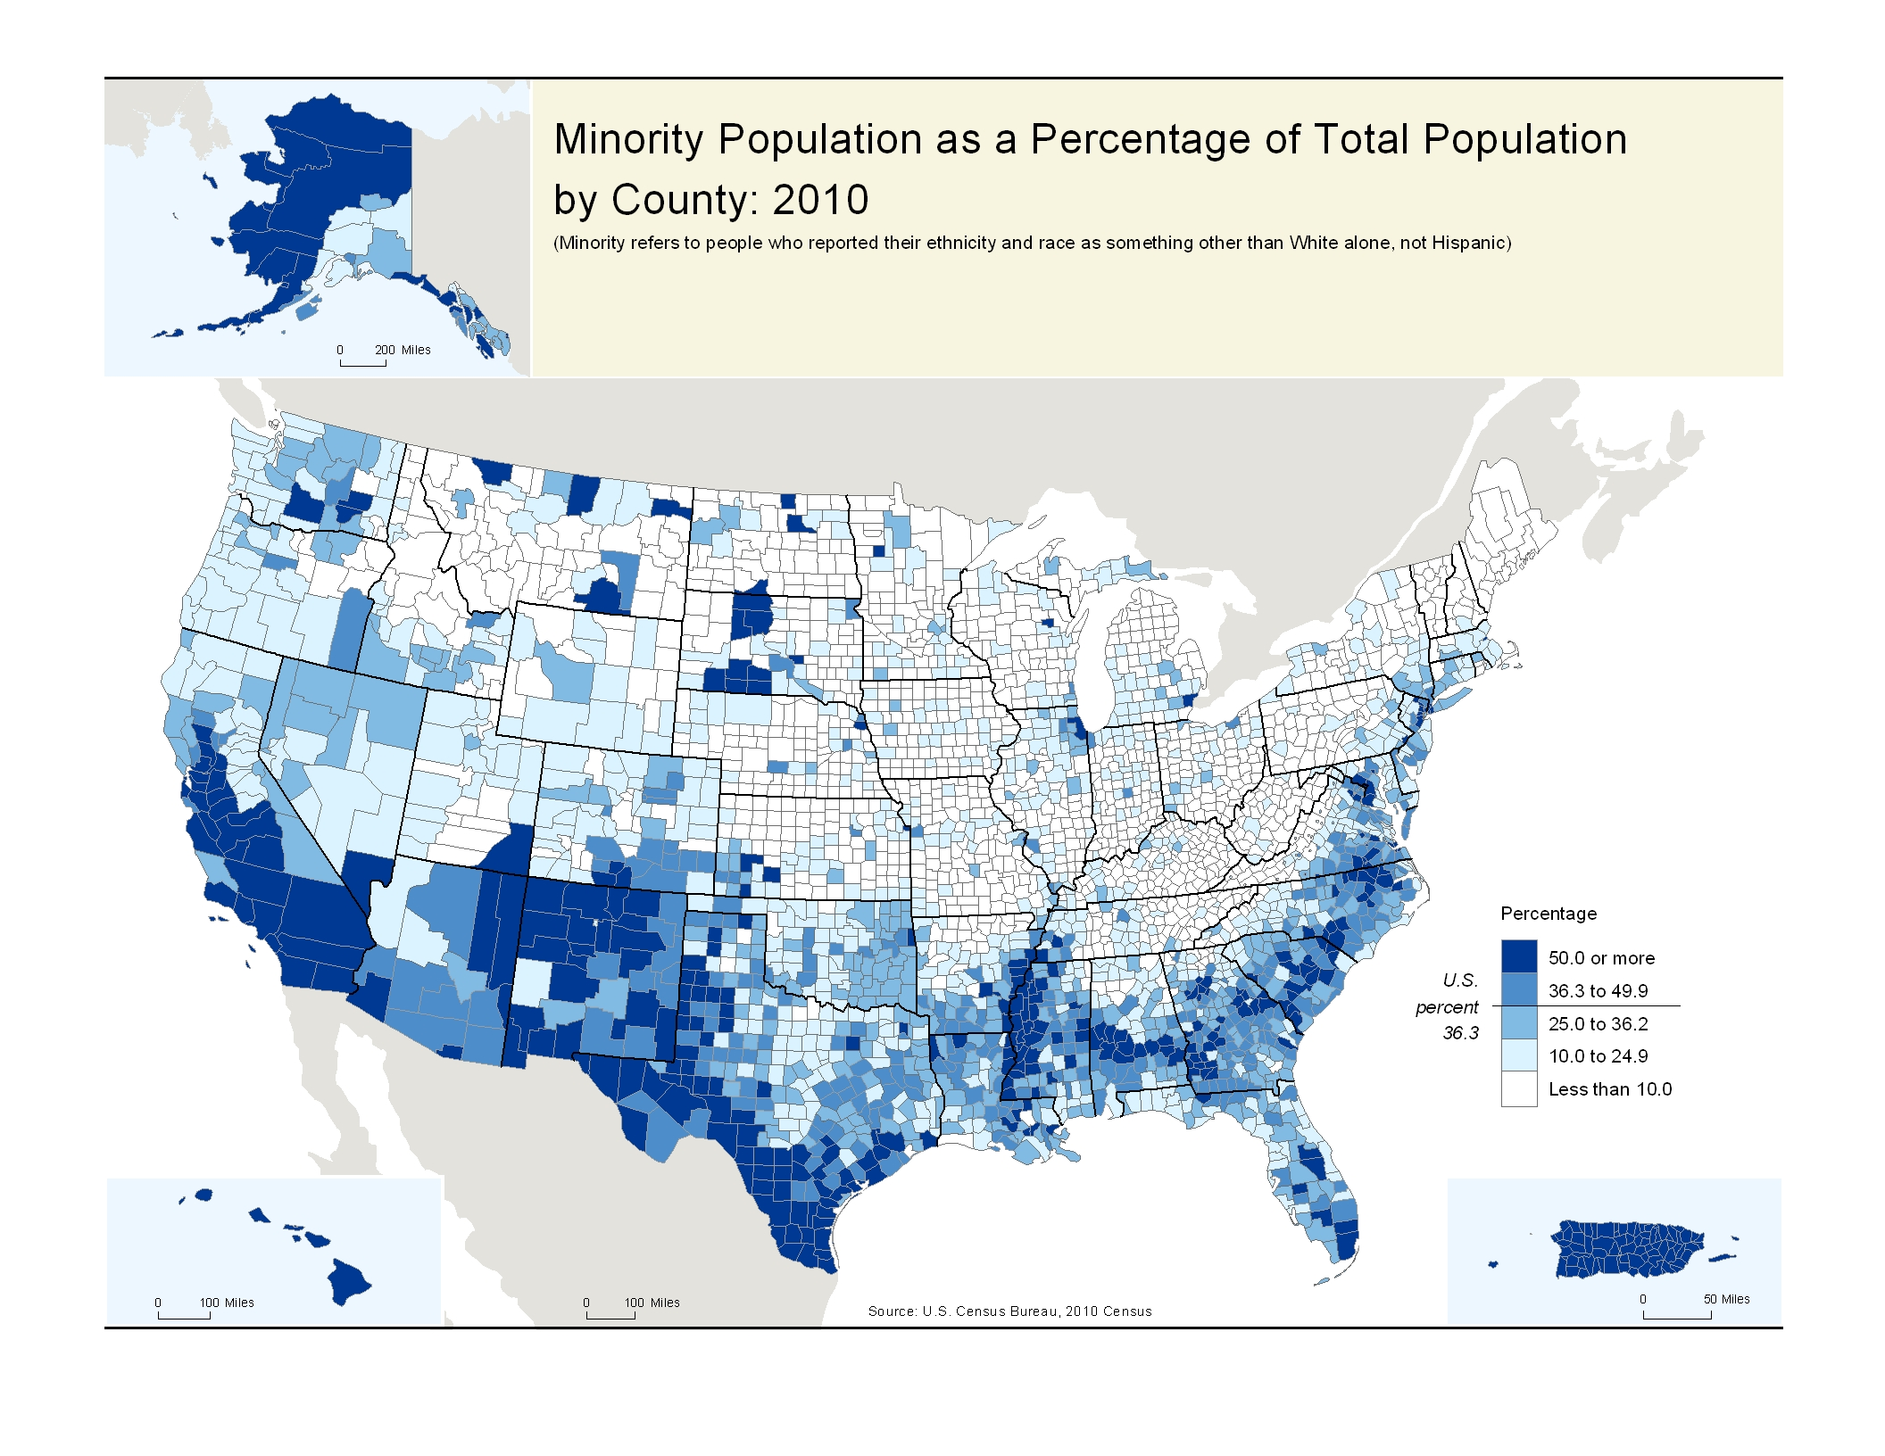
Northeast 31.3%
Midwest 22.2%
West 47.2%
South 40.0%
Notes:
Across the country,
the proportion of the total population
that was “minority”
ranged from about 22% in the Midwest,
31% in the Northeast,
40% in the South,
to 47% in the West.

Slide 27
Minority Population

Slide 28
Minority Population Growth Western States
State | 2000 | 2010 | Numeric Change | % Change
West | 26,286,345 | 33,939,190 | 7,652,845 | 29.1%
Alaska | 203,144 | 254,911 | 51,767 | 25.5%
Arizona | 1,856,374 | 2,696,370 | 839,996 | 45.2%
California | 18,054,858 | 22,297,703 | 4,242,845 | 23.5%
Colorado | 1,098,381 | 1,508,403 | 410,022 | 37.3%
Hawaii | 934,446 | 1,050,958 | 116,512 | 12.5%
Idaho | 154,662 | 251,339 | 96,677 | 62.5%
Montana | 94,372 | 120,787 | 26,415 | 28.0%
Nevada | 695,256 | 1,238,470 | 543,214 | 78.1%
New Mexico | 1,005,551 | 1,225,369 | 219,818 | 21.9%
Oregon | 563,783 | 825,226 | 261,443 | 46.4%
Utah | 328,904 | 542,166 | 213,262 | 64.8%
Washington | 1,241,631 | 1,847,736 | 606,105 | 48.8%
Wyoming | 54,983 | 79,752 | 24,769 | 45.0%

Slide 29
Minority Population by State
State | Total Population | Minority | Percent
West | 71,945,553 | 33,939,190 | 47.2%
Alaska | 710,231 | 254,911 | 35.9%
Arizona | 6,392,017 | 2,696,370 | 42.2%
California | 37,253,956 | 22,297,703 | 59.9%
Colorado | 5,029,196 | 1,508,403 | 30.0%
Hawaii | 1,360,301 | 1,050,958 | 77.3%
Idaho | 1,567,582 | 251,339 | 16.0%
Montana | 989,415 | 120,787 | 12.2%
Nevada | 2,700,551 | 1,238,470 | 45.9%
New Mexico | 2,059,179 | 1,225,369 | 59.5%
Oregon | 3,831,074 | 825,226 | 21.5%
Utah | 2,763,885 | 542,166 | 19.6%
Washington | 6,724,540 | 1,847,736 | 27.5%
Wyoming | 563,626 | 79,752 | 14.1%

Slide 30
Diversity in the West
The Hispanic or Latino Population
The West has the largest number of Hispanics or Latinos –
both in terms of numbers (20,596,439) and in percentage
of total population (28.6%) than any region.
41% of all Hispanics in the United States (50,477,594)
live in the West.
Growth in the Hispanic population (5,255,936) accounted
for 60% of the region’s total growth (8,747,621)
 | 2000 | 2010 | Numeric Change | % Change
West | 63,197,932 | 71,945,553 | 8,747,621 | 13.8%
Hispanic | 15,340,503 | 20,596,439 | 5,255,936 | 34.3%

Slide 31
Hispanic or Latino Population

Slide 32
Hispanic Population Growth Western States
State | 2000 | 2010 | Numeric Change | % Change
West | 15,340,503 | 20,596,439 | 5,255,936 | 34.3%
Alaska | 25,852 | 39,249 | 13,397 | 51.8%
Arizona | 1,295,617 | 1,895,149 | 599,532 | 46.3%
California | 10,966,556 | 14,013,719 | 3,047,163 | 27.8%
Colorado | 735,601 | 1,038,687 | 303,086 | 41.2%
Hawaii | 87,699 | 120,842 | 33,143 | 37.8%
Idaho | 101,690 | 175,901 | 74,211 | 73.0%
Montana | 18,081 | 28,565 | 10,484 | 58.0%
Nevada | 393,970 | 716,501 | 322,531 | 81.9%
New Mexico | 765,386 | 953,403 | 188,017 | 24.6%
Oregon | 275,314 | 450,062 | 174,748 | 63.5%
Utah | 201,559 | 358,340 | 156,781 | 77.8%
Washington | 441,509 | 755,790 | 314,281 | 71.2%
Wyoming | 31,669 | 50,231 | 18,562 | 58.6%

Slide 33
Hispanic Population by State
State | Total Population | Hispanic | Percent
West | 71,945,553 | 20,596,439 | 28.6%
Alaska | 710,231 | 39,249 | 5.5%
Arizona | 6,392,017 | 1,895,149 | 29.6%
California | 37,253,956 | 14,013,719 | 37.6%
Colorado | 5,029,196 | 1,038,687 | 20.7%
Hawaii | 1,360,301 | 120,842 | 8.9%
Idaho | 1,567,582 | 175,901 | 11.2%
Montana | 989,415 | 28,565 | 2.9%
Nevada | 2,700,551 | 716,501 | 26.5%
New Mexico | 2,059,179 | 953,403 | 46.3%
Oregon | 3,831,074 | 450,062 | 11.7%
Utah | 2,763,885 | 358,340 | 13.0%
Washington | 6,724,540 | 755,790 | 11.2%
Wyoming | 563,626 | 50,231 | 8.9%

Slide 34
Diversity in the West
The Asian Population
The West has the highest concentration of Asian
population – 6,670,950
9.3% of the West’s population is Asian.
46% of the nation’s Asian population of 14,465,124 are
residents of the West.
Growth in the Asian population (1,667,339) accounted
for 19% of the region’s total growth (8,747,621)
 | 2000 | 2010 | Numeric Change | % Change
West | 63,197,932 | 71,945,553 | 8,747,621 | 13.8%
Asian | 5,003,611 | 6,670,950 | 1,667,339 | 33.3%

Slide 35
Asian Population Growth Western States
State | 2000 | 2010 | Numeric Change | % Change
West | 5,003,611 | 6,670,950 | 1,667,339 | 33.3%
Alaska | 25,116 | 38,135 | 13,019 | 51.8%
Arizona | 92,236 | 176,695 | 84,459 | 91.6%
California | 3,697,513 | 4,861,007 | 1,163,494 | 31.5%
Colorado | 95,213 | 139,028 | 43,815 | 46.0%
Hawaii | 503,868 | 525,078 | 21,210 | 4.2%
Idaho | 11,889 | 19,069 | 7,180 | 60.4%
Montana | 4,691 | 6,253 | 1,562 | 33.3%
Nevada | 90,266 | 195,436 | 105,170 | 116.5%
New Mexico | 19,255 | 28,208 | 8,953 | 46.5%
Oregon | 101,350 | 141,263 | 39,913 | 39.4%
Utah | 37,108 | 55,285 | 18,177 | 49.0%
Washington | 322,335 | 481,067 | 158,732 | 49.2%
Wyoming | 2,771 | 4,426 | 1,655 | 59.7%

Slide 36
Asian Population by State
State | Total Population | Asian | Percent
West | 71,945,553 | 6,670,950 | 9.3%
Alaska | 710,231 | 38,135 | 5.4%
Arizona | 6,392,017 | 176,695 | 2.8%
California | 37,253,956 | 4,861,007 | 13.0%
Colorado | 5,029,196 | 139,028 | 2.8%
Hawaii | 1,360,301 | 525,078 | 38.6%
Idaho | 1,567,582 | 19,069 | 1.2%
Montana | 989,415 | 6,253 | 0.6%
Nevada | 2,700,551 | 195,436 | 7.2%
New Mexico | 2,059,179 | 28,208 | 1.4%
Oregon | 3,831,074 | 141,263 | 3.7%
Utah | 2,763,885 | 55,285 | 2.0%
Washington | 6,724,540 | 481,067 | 7.2%
Wyoming | 563,626 | 4,426 | 0.8%

Slide 37
The Foreign-Born Population
The West contains the largest concentration of the foreign born in the Nation – 13,867,376.
They comprise 19% of the region.
36% of all persons in the United States who are foreign born (38,517,234) reside in the West.

Slide 38
Foreign-Born Population by State
State | Total Population | Foreign-Born | Percent
West | 71,945,553 | 13,867,376 | 19.3%
Alaska | 710,231 | 48,849 | 6.9%
Arizona | 6,392,017 | 925,376 | 14.5%
California | 37,253,956 | 9,949,758 | 26.7%
Colorado | 5,029,196 | 486,615 | 9.7%
Hawaii | 1,360,301 | 224,227 | 16.5%
Idaho | 1,567,582 | 97,642 | 6.2%
Montana | 989,415 | 19,309 | 2.0%
Nevada | 2,700,551 | 506,505 | 18.8%
New Mexico | 2,059,179 | 196,006 | 9.5%
Oregon | 3,831,074 | 367,202 | 9.6%
Utah | 2,763,885 | 218,142 | 7.9%
Washington | 6,724,540 | 810,637 | 12.1%
Wyoming | 563,626 | 17,108 | 3.0%
2009 American Community Survey

Slide 39
Home Ownership 2009 American Community Survey

Slide 40
Median Value Owner-Occupied Housing Units
 | 2000 | 2006 Estimate | 2007 Estimate | 2008 Estimate | 2009 Estimate
U.S. | $111,800 | $197,000 | $201,000 | $196,700 | $185,200
Alaska | 137,400 | 226,800 | 239,300 | 235,200 | 232,900
Arizona | 109,400 | 251,600 | 245,900 | 228,300 | 187,700
California | 198,900 | 569,900 | 550,600 | 465,100 | 384,200
Colorado | 160,100 | 247,800 | 242,000 | 241,200 | 237,800
Hawaii | 249,300 | 563,500 | 574,600 | 556,600 | 517,600
Idaho | 102,100 | 174,400 | 184,300 | 183,100 | 171,700
Montana | 95,800 | 165,400 | 175,900 | 179,800 | 176,300
New Mexico | 132,500 | 150,200 | 160,800 | 164,400 | 160,900
Nevada | 94,600 | 335,300 | 322,000 | 270,200 | 207,600
Oregon | 145,800 | 251,700 | 266,200 | 271,700 | 257,400
Utah | 142,600 | 200,600 | 226,200 | 235,100 | 224,700
Washington | 158,800 | 284,700 | 311,200 | 306,800 | 287,200
Wyoming | 91,500 | 158,400 | 178,300 | 186,700 | 184,000
2009 American Community Survey

Slide 41
Median Value Owner-Occupied Housing Units

Slide 42
Median Value Owner-Occupied Housing Units

Slide 43
Median Household Income: 2009 ACS
Dollars

Slide 44
Resources: Need Assistance?
U.S. Census Bureau
Partnership & Data Services Program
15350 Sherman Way, Suite 400
Van Nuys, CA 91406
(888) 806-6389 Toll Free
L.A. Regional Website: www.census.gov/losangeles
laro.isp-partnership@census.gov
Jerry.B.Wong@census.gov
Notes:
44
44

