Slide 1
Economic Data from the U.S. Census Bureau
A Business Plan Case Study
HI SDC and Affiliate Workshops
February 23-27, 2015
Presented by:
Andrew W. Hait
U.S. Census Bureau

Slide 2
Outline
Using Census Bureau Economic Programs Data To Better Understand
  The target market of a proposed business
  The local competition
  The national industry

Slide 3
Sample Scenario:
An entrepreneur is interested in opening a day care center in Honolulu County.
She wants to know what information is available from the Census Bureau that may help her locate the business and better understand this industry.

Slide 4
Measuring the Need…
The demographic data available from the ACS helps make the case for this type of business…
 | Hawaii |  | Hawaii County, Hawaii |  | Honolulu County, Hawaii |  | Kauai County, Hawaii |  | Maui County, Hawaii
Total population | 1,392,313 |  | 189,191 |  | 976,372 |  | 68,434 |  | 158,226
Male | 701,196 | 50.4 | 95,040 | 50.2 | 492,228 | 50.4 | 34,515 | 50.4 | 79,365 | 50.2
Female | 691,117 | 49.6 | 94,151 | 49.8 | 484,144 | 49.6 | 33,919 | 49.6 | 78,861 | 49.8
Under 5 years | 89,013 | 6.4 | 11,908 | 6.3 | 62,694 | 6.4 | 4,383 | 6.4 | 10,028 | 6.3
5 to 9 years | 83,474 | 6.0 | 12,039 | 6.4 | 56,636 | 5.8 | 3,647 | 5.3 | 11,152 | 7.0
10 to 14 years | 82,207 | 5.9 | 11,117 | 5.9 | 58,259 | 6.0 | 4,327 | 6.3 | 8,504 | 5.4
15 to 19 years | 82,212 | 5.9 | 11,783 | 6.2 | 57,165 | 5.9 | 4,196 | 6.1 | 9,068 | 5.7
20 to 24 years | 103,126 | 7.4 | 11,473 | 6.1 | 79,423 | 8.1 | 3,422 | 5.0 | 8,804 | 5.6
25 to 34 years | 199,308 | 14.3 | 23,141 | 12.2 | 146,256 | 15.0 | 8,611 | 12.6 | 21,265 | 13.4

Slide 5
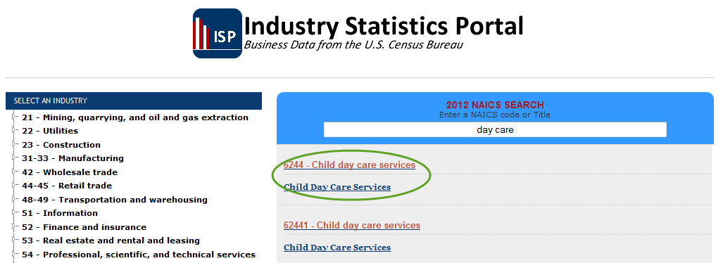
Getting Started
What NAICS code covers this industry?
What Census programs provide data for this industry?
Notes:
ISP provides access to all data from Census for a given industry.\
2 methods of selecting the industry – tree and search.
Higher-level (less digits) NAICS almost always better.

Slide 6
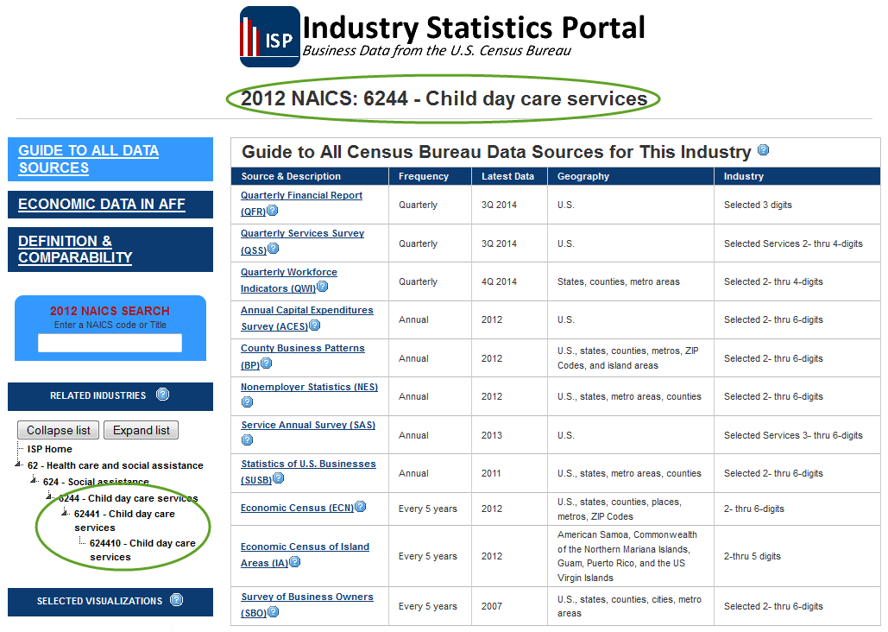
What Programs Cover this Industry?
Notes:
Guide page shows all sources
Related Industries tree allows further access

Slide 7
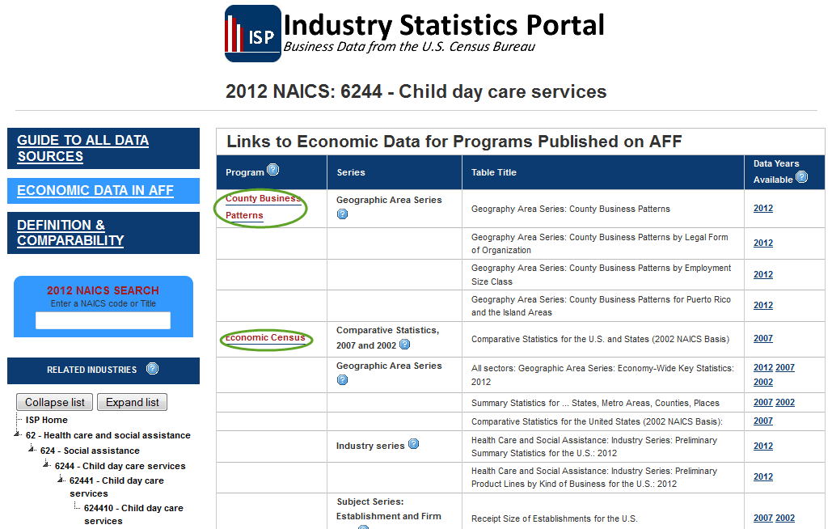
How Can I Get to the Data?
Notes:
For programs NOT in AFF, use Guide page.
For programs IN AFF, use 2nd tab.

Slide 8
Tell Me About This Industry in Honolulu County…
The County Business Patterns (CBP) program provides data that she can use to better understand this industry, her competition, and her potential market.

Slide 9
Child day care services (NAICS 6244) in Hawaii: 2012
Geographic area name | Number of establish-ments | Paid employees for pay period including March 12 (number) | First-quarter payroll ($1,000) | Annual payroll ($1,000) | Paid employees per establish-ment | Annual payroll per employee ($) | Pop under 5 | Pop per establish-ment
Hawaii | 233 | 2,655 | 12,512 | 50,862 | 11 | 19,157 | 89,013 | 382
Hawaii County, Hawaii | 30 | e | 1,322 | 4,871 |  |  | 11,908 | 397
Honolulu County, Hawaii | 161 | 2,039 | 10,076 | 41,458 | 13 | 20,333 | 62,694 | 389
Kauai County, Hawaii | 13 | 98 | 453 | 1,789 | 8 | 18,255 | 4,383 | 337
Maui County, Hawaii | 29 | 211 | 661 | 2,744 | 7 | 13,005 | 10,028 | 346
Notes:
To get to these data in American FactFinder:
Choose the Advanced Search option
To select the industry from the Industries menu, type in 6244 in the search box and select the industry from the list
Filter to the most current year by choosing 2012 from the drop down box in the upper right corner of the search results list
Select 2012 County Business Patterns A1 table from the tables list
Download the data to Excel
Merge the population data previously downloaded with the CBP data, create the ratios, and format the display as desired.

Slide 10

How Is this Industry Performing Nationally?
The Quarterly Services Survey (QSS) provides National-level data that she can use to measure changes in this industry and to better understand its seasonal fluctuations.

Slide 11
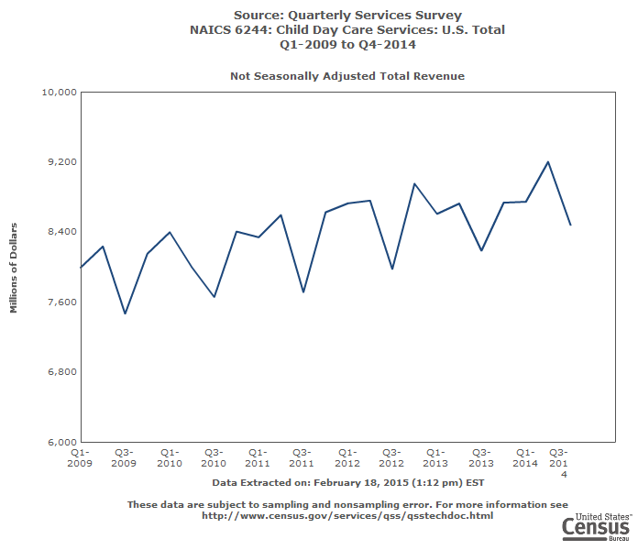

Slide 12

What About Data for My Local Area?
The Economic Census (EC) provides place-level (and even ZIP Code-level) data (including Revenue data not available from CBP) that she can use to better understand her potential market and local competition.

Slide 13
Child day care services (NAICS 6244) in Honolulu County Places: 2007
Geographic area name | Number of employer establishments | Employer value of sales, shipments, receipts, revenue, or business done ($1,000) | Annual payroll ($1,000) | Number of paid employees for pay period including March 12
Honolulu CDP, Hawaii | 63 | 38,485 | 18,657 | 980
Kailua CDP (Honolulu County), Hawaii | 14 | 4,278 | 1,848 | 117
Mililani Town CDP, Hawaii | 5 | D | D | 20-99
Waimalu CDP, Hawaii | 7 | D | D | 20-99
Waipahu CDP, Hawaii | 4 | D | D | 20-99
Balance of Honolulu County, Hawaii | 22 | D | D | 100-249

Slide 14
I’ve Heard about Nonemployers… What are They?
Nonemployers are businesses with no paid employees.
Primarily independent contractors
File IRS Form 1040 Schedule C
Significant in number
Significant in revenue in some industries

Slide 15
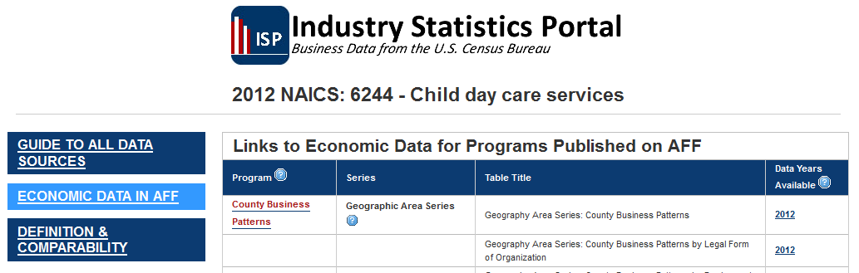
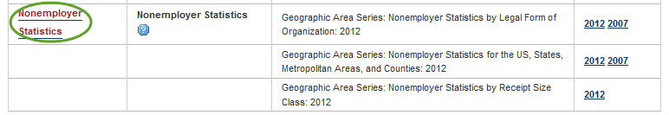
More Data…

Slide 16
Nonemployer Child day care services (NAICS 6244) in Hawaii: 2012
Geographic area name | Number of nonemployer establishments | Receipts ($1,000) | Receipts per establishment ($)
Hawaii | 1,102 | 20,387 | 18,500
Hawaii County, Hawaii | 200 | 3,326 | 16,630
Honolulu County, Hawaii | 663 | 11,175 | 16,855
Kauai County, Hawaii | 76 | 1,505 | 19,803
Maui County, Hawaii | 163 | 4,381 | 26,877

Slide 17
What Services do Businesses in this Industry Provide?
Data on products and services sold by businesses are available in the Product Lines data from Economic Census.
Can be used in a business plan to identify the primary and secondary sources of sales of the business

Slide 18
Broad and Detailed Product Lines for Child day care services (NAICS 6244) in Hawaii: 2007
Meaning of Products and services code | Number of establishments | Total sales, receipts, or revenue of establishments with the product line ($1,000) | Receipts/Revenue ($1,000) | Sales, receipts, or revenue of product line as percent of total sales, receipts, or revenue of industry (%)
Industry total | 202 | X | 83,527 | 100.0
Social assistance services for children, youth, & families | 132 | 42,266 | 35,953 | 43.0
Social assistance for families - Child day care services | 132 | 42,266 | 35,580 | 42.6
Social assistance for families - Other | 8 | 6,824 | 355 | 0.4
Pre-primary grade instructional programs | 43 | 23,573 | 20,513 | 24.6
Contributions, gifts, & grants - Government | 33 | 25,109 | 18,586 | 22.3
Contributions, gifts, & grants - Private | 16 | 19,091 | 4,897 | 5.9
All other revenue | 14 | 15,542 | 1,263 | 1.5

Slide 19

How Big Should A Business Be?
The Economic Census includes data broken out by the sales and employment size of the business
Can be used in a business plan to understand the size of a “typical” business in an industry
Can also be used to forecast the future growth of a business to it’s most efficient size

Slide 22
Anything Else?
The Economic Census and the Survey of Business Owners publish detailed data that is tailored to specific industries
Can be used to further understand the composition of an industry

Slide 23
Child day care services (NAICS 6244) in Hawaii by Tax Status: 2007
Geographic area name | Meaning of Type of operation or tax status code | Number of employer establishments | Employer value of sales, shipments, receipts, revenue, or business done ($1,000) | Annual payroll ($1,000) | Number of paid employees for pay period including March 12
Hawaii | All establishments | 202 | 83,527 | 40,802 | 2,248
Hawaii | Establishments subject to federal income tax | 30 | 12,655 | 5,994 | 274
Hawaii | Establishments exempt from federal income tax | 172 | 70,872 | 34,808 | 1,974
Hawaii County, Hawaii | All establishments | 28 | D | D | c
Hawaii County, Hawaii | Establishments exempt from federal income tax | 23 | D | D | c
Honolulu County, Hawaii | All establishments | 139 | 69,406 | 33,142 | 1,765
Honolulu County, Hawaii | Establishments subject to federal income tax | 18 | 10,303 | 4,869 | 207
Honolulu County, Hawaii | Establishments exempt from federal income tax | 121 | 59,103 | 28,273 | 1,558
Kauai County, Hawaii | All establishments | 12 | D | D | b
Kauai County, Hawaii | Establishments exempt from federal income tax | 11 | D | D | b
Maui County, Hawaii | All establishments | 23 | D | D | c
Maui County, Hawaii | Establishments exempt from federal income tax | 17 | D | D | c

Slide 24
Child day care services (NAICS 6244) in Hawaii by Owner's Race or Gender: 2007
Meaning of Race code | Number of firms with or without paid employees | Sales, receipts, or value of shipments of firms with or without paid employees ($1,000) | Number of firms with paid employees | Sales, receipts, or value of shipments of firms with paid employees ($1,000) | Number of paid employees for pay period including March 12 | Annual payroll ($1,000) | Number of firms without paid employees | Sales, receipts, or value of shipments of firms without paid employees ($1,000)
All firms | 1,359 | 117,191 | 96 | 97,753 | 3,135 | 56,945 | 1,263 | 19,438
White | 538 | 15,308 | 17 | 8,078 | 219 | 3,877 | 520 | 7,229
Asian | 640 | 10,759 | 1 | D | a | D | 639 | 10,614
Native Hawaiian | 197 | 2,774 | 0 | 0 | 0 | 0 | 197 | 2,774
Minority | 914 | 14,229 | 1 | D | a | D | 913 | 14,084
Nonminority | 312 | 12,110 | 16 | 7,934 | 215 | 3,813 | 295 | 4,176
Female-owned | 973 | 21,738 | 16 | 7,501 | 206 | 3,549 | 957 | 14,236
Publicly held and other firms not classifiable by gender, ethnicity, race, and veteran status | 78 | 89,628 | 78 | 89,628 | 2,914 | 53,047 | 0 | 0

Slide 25
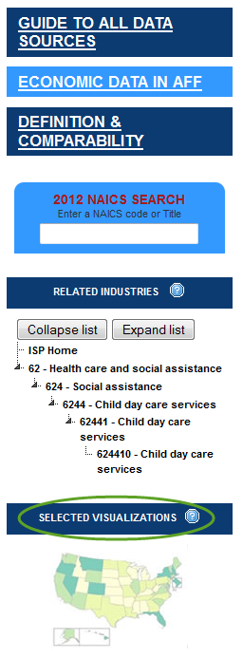
Visualizations?
The Industry Statistics Portal also provides access to visualization of selected economic data.
Can be used in business plans and presentations

Slide 26
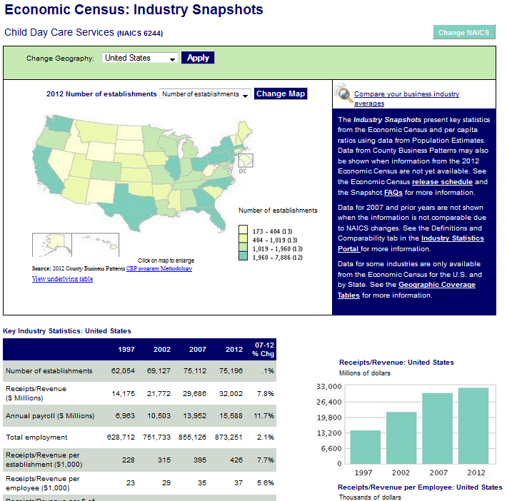
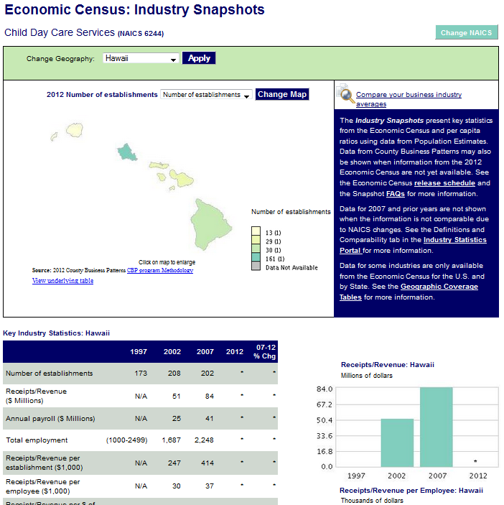

Slide 27
Is There an Easier Way to Get All This Great Information?
American FactFinder, the Industry Statistics Portal, and the other tools shown provide access all of these data, but can be hard to use…
Enter Census Business Development Tool: Entrepreneur Edition…

Slide 28
Beta Tool: Entrepreneur Edition
This tool provides easy access to key demographic and economic information from the U.S. Census Bureau and other sources that entrepreneurs can use in their business plans and to make informed decisions. The tool provides access to this information in 4 Easy Steps:
Powered by the U.S. Census Bureau and Esri. For help using this tool, see the FAQs. For information about data from other Census programs, see www.census.gov.
Step 1: Select my Type of Business
Step 3: Refine my business location using data
Step 4: View and download a Profile of my Location and Type of Business
Step 2: Select the Area where I'm thinking about opening my business
Notes:
One of the first piece of feedback we got on the beta release was that the 4 basic steps the user has to go thru to use the tool weren’t as clear as they could be, so after clicking on the link to the tool on census.gov, a splash screen will now be presented. This splash screen describes the purpose of the tool, the 4 basic steps, and provides links to FAQs and other information.
Closing the splash screen brings the user to…

Slide 29

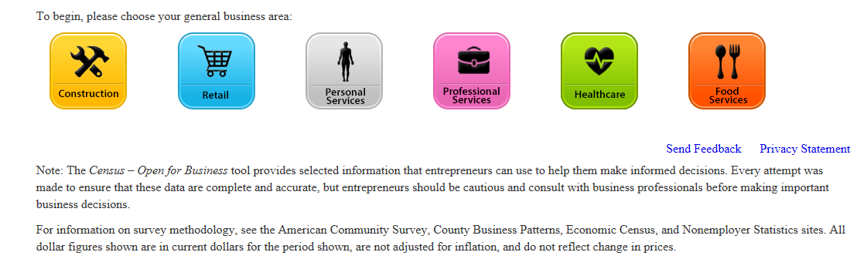
Beta Tool: Entrepreneur Edition
Step 1: Select my Type of Business
Step 3: Refine my business location using data
Step 4: View a Profile of my Location and Type of Business
Step 2: Select the Geographic Area being considered
Notes:
…the first screen of the tool, which presents a list of broad industry categories for the entrepreneur to select the type of business he/she is considering opening. This screen also highlights this as step 1 of 4.
In this case, we’ll select “Professional Services”.

Slide 30
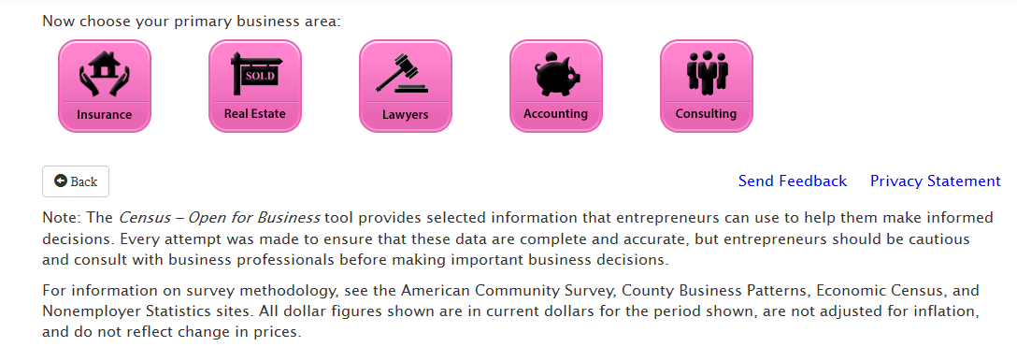
Beta Tool : Entrepreneur Edition
Step 1: Select my Type of Business
Step 3: Refine my business location using data
Step 4: View a Profile of my Location and Type of Business
Step 2: Select the Geographic Area being considered
Notes:
Clicking on a broad category brings the user to a list of the detailed types of businesses. For version 1.0, this list of industries has been expanded from the 17 types of businesses covered in the beta to 29 different industries (see list below). Versions 1.1, 1.2, and later versions will further expand this list.
In this case, we’re selecting Real Estate.
Construction:
Electrical (NAICS 23821) Flooring (NAICS 23833) Painting and wall paper (NAICS 23832) Plumbing (NAICS 23822)
Food Services:
Caterers (NAICS 72232) Drinking places (NAICS 7224) Restaurants (NAICS 722511) Fast Food (NAICS 722513)
Health Care:
Chiropractors (NAICS 62131) Dentists (NAICS 62121) Doctors (NAICS 62111) Therapists (NAICS 62134) Optometrists (NAICS 62132)
Personal Services:
Auto repair (NAICS 8111) Beauty salons (NAICS 812112) Day Care (NAICS 62441) Landscaping (NAICS 56173) Taxi services (NAICS 48531) Travel agencies (NAICS 56151)
Professional Services:
Accounting (NAICS 54121) Consulting (NAICS 54161) Insurance (NAICS 52421) Lawyers (NAICS 54111) Real Estate (NAICS 53121)
Retail:
Liquor Stores (NAICS 44531) Convenience Stores (NAICS 44512) Florists (NAICS 45311) Gas Stations (NAICS 4471) Used Car Dealers (NAICS 44112)

Slide 31
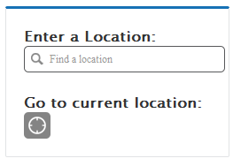
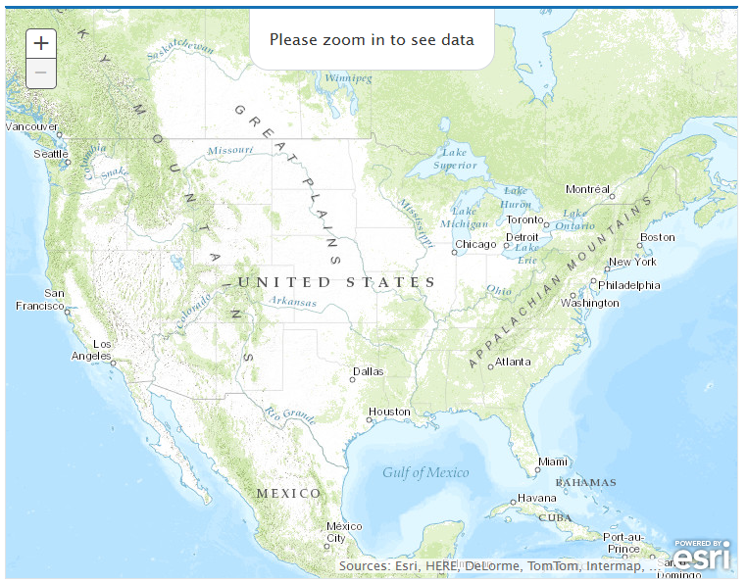
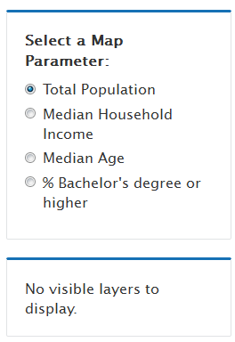
Beta Tool : Entrepreneur Edition
Step 1: Select my Type of Business
Step 3: Refine my business location using data
Step 4: View a Profile of my Location and Type of Business
Step 2: Step 2: Select the Geographic Area being considered
No Map Parameters Selected
Choose a location first
Notes:
After selecting their type of business in step 1, in step 2 the user selects the area where they are considering opening the business. 3 ways of making this selection are provided…
entering a location in the search box,
going to the location where the user is currently physically located, or
using the map to zoom to the location.

Slide 32
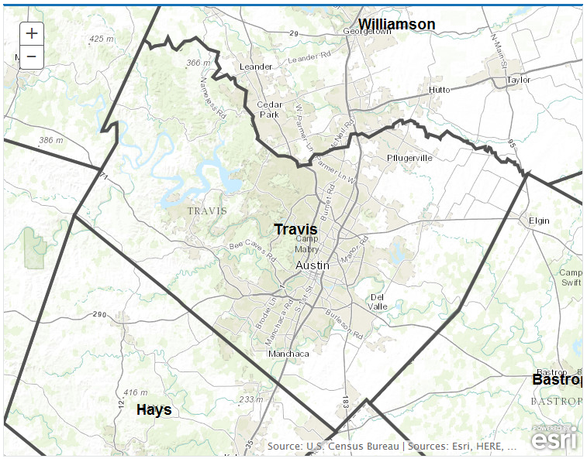
Beta Tool : Entrepreneur Edition
Step 1: Select my Type of Business
Step 3: Refine my business location using data
Step 4: View a Profile of my Location and Type of Business
Step 2: Select the Geographic Area being considered
Austin, TX
Map Parameters:
+ My Customers
+ Demographic Characteristics
+ Total population
+ Population 18+
+ Population 65+
+ Economic Characteristics
+ Housing Characteristics
+ Other Businesses Like Mine
+ Consumer Spending
Display Filter
Geographic Level Shown: County Place ZIP Code Tract (choose level)
Notes:
In this case, the user has selected Austin TX, and the map zooms to Travis County.
After selecting the area, the Map Parameters menu also builds. This menu not only includes the 4 demographic characteristics provided in the beta version but also adds additional demographic and economic characteristics of the proposed business’ customers and competitors. In addition, based on feedback from users, an initial set of 3rd party data (Consumer Spending) is also now available.
The user can now further refine the area where he/she is considering locating their business using the data presented in the Map Parameters menu. This is Step 3 in the process.

Slide 33
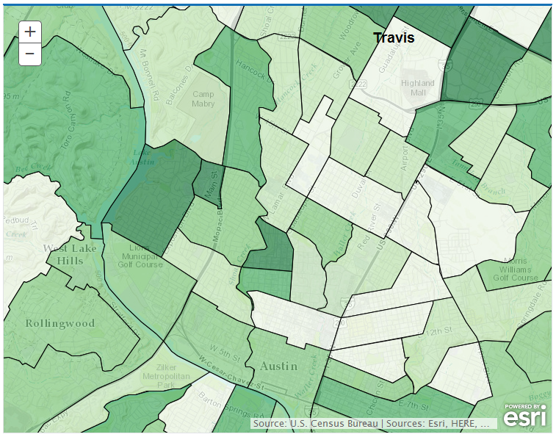
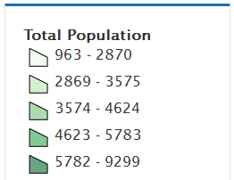
Beta Tool : Entrepreneur Edition
Step 1: Select my Type of Business
Step 3: Refine my business location using data
Step 4: View a Profile of my Location and Type of Business
Step 2: Select the Geographic Area being considered
Display parameter: Total population Filter Parameter(s): None
Austin, TX
Map Parameters:
+ My Customers
+ Demographic Characteristics
+ Total population
+ Population 18+
+ Population 65+
+ Economic Characteristics
+ Housing Characteristics
+ Other Businesses Like Mine
+ Consumer Spending
Display Filter
Geographic Level Shown: County Place ZIP Code Tract (choose level)
Notes:
Using the Map Parameters menu, the user can choose the data variable to display on the map. In this case, we have selected Total Population, which is highlighted in red in the menu and is also shown at the top of the map. “Display” is also highlighted in the options below the Map Parameters menu.

Slide 34
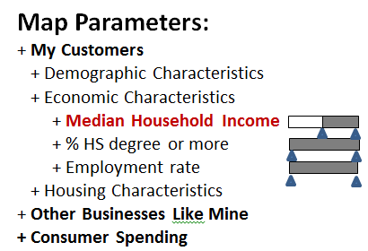
Beta Tool : Entrepreneur Edition
Step 1: Select my Type of Business
Step 3: Refine my business location using data
Step 4: View a Profile of my Location and Type of Business
Step 2: Select the Geographic Area being considered
Display parameter: Total population Filter Parameter(s): Median HH Income > $100,000
Austin, TX
Display Filter
Geographic Level Shown: County Place ZIP Code Tract (choose level)
Notes:
Using the Map Parameters menu, the user can also choose up to 3 variables to filter the areas presented in the map on. In this case, we have selected Median Household Income > $100,000 , which is highlighted in red in the menu and is also shown at the top of the map. “Filter” is also highlighted in the options below the Map Parameters menu.
In addition to choosing the data to view, this page also allows the user to zoom from County down to lower geographic levels and back up again. At the bottom of the map is a menu that allows the user to do this In this case, the user has drilled down to see tracts in Austin. Drilling down in the map modifies the parameters menu by not including parameters that aren’t available at the lower geographic levels.
Once the user has decided on the area he/she is interested in, clicking on that area on the map brings up a popup containing the data and the link to the profile report.

Slide 35
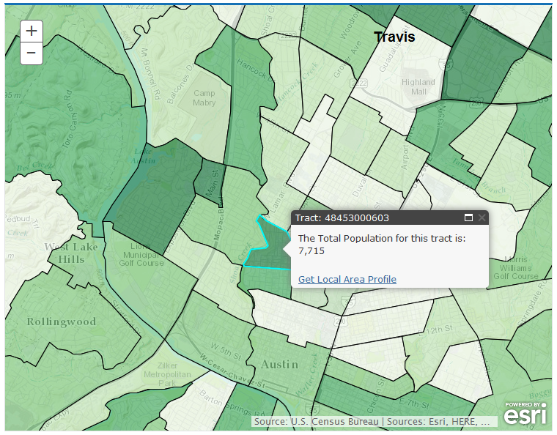
Beta Tool : Entrepreneur Edition
Step 1: Select my Type of Business
Step 3: Refine my business location using data
Step 4: View a Profile of my Location and Type of Business
Step 2: Select the Geographic Area being considered
Display parameter: Total population Filter Parameter(s): Median HH Income > $100,000
Austin, TX
Map Parameters:
+ My Customers
+ Demographic Characteristics
+ Total population
+ Population 18+
+ Population 65+
+ Economic Characteristics
+ Housing Characteristics
+ Other Businesses Like Mine
+ Consumer Spending
Display Filter
Geographic Level Shown: County Place ZIP Code Tract (choose level)
Notes:
Once the user has decided on the area he/she is interested in, clicking on that area on the map brings up a popup containing the data and the link to the profile report. This is step 4…

Slide 36
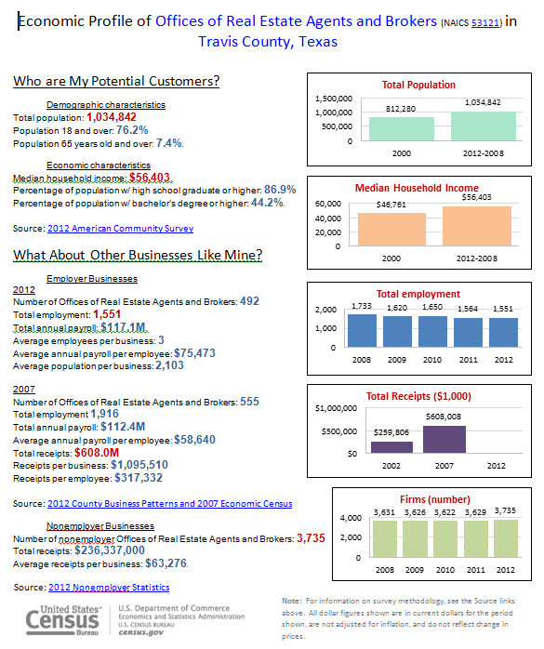
Notes:
This report includes all of the data shown in the Parameters menu as well as time series bar charts. The report can be printed off or downloaded as an rtf file… future versions of the tool will include export to Excel and a Business Plan template functionality.

Slide 37
CBDT Next Steps
Tool is scheduled for release on Business page on Census.gov in Late April/Early May 2015
Quarterly updates planned, with future versions adding in additional industries, data items, and functionality
Will continue to collect feedback to inform later updates
CBDT platform being leveraged to create Chamber of Commerce Edition (scheduled for beta release in August 2015)

Slide 38
Summary
Economic Programs data from the Census Bureau can be an invaluable source of information in a business plan to measure:
  The target market of a business
  The overall health and composition of the industry and competing businesses
  The impact of complementary businesses on the location of the business
  The roll that business suppliers can have on the location of a business

Slide 39

Questions

Slide 40
Any other Questions: andrew.w.hait@census.gov
(301)763-6747
Thank You!

