Slide 1
2012
Economic Census
Update
HI SDC and Affiliate Workshops
February 23-27, 2015
Presented by: Andrew W. Hait
Economic Data Product and Data User Liaison
U.S. Census Bureau

Slide 2
Outline
Census Economic Programs Primer
Our New business.census.gov Site
  What’s Been Released So Far
  What’s Coming Up (Geographic Area Series, etc.)
Related Economic Programs
Other New Offerings

Slide 3
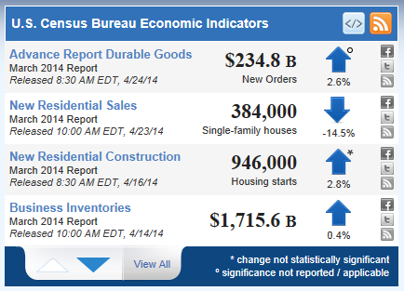
Census Economic Data
Monthly and Quarterly Data
  Leading Economic Indicators, like Monthly Retail Sales
Annual Data
  Annual Survey of Manufactures
The Economic Census and Related Programs

Slide 4

Key Economic Census Terms
NAICS (North American Industry Classification System)
  Our primary data dimension
Establishments (vs. Companies, Firms, etc.)
  Our collection/tabulation level
Employers (vs. Nonemployers)
  EC only covers employer businesses
U.S. Code Title 13 and 26
  Protects business privacy

Slide 5
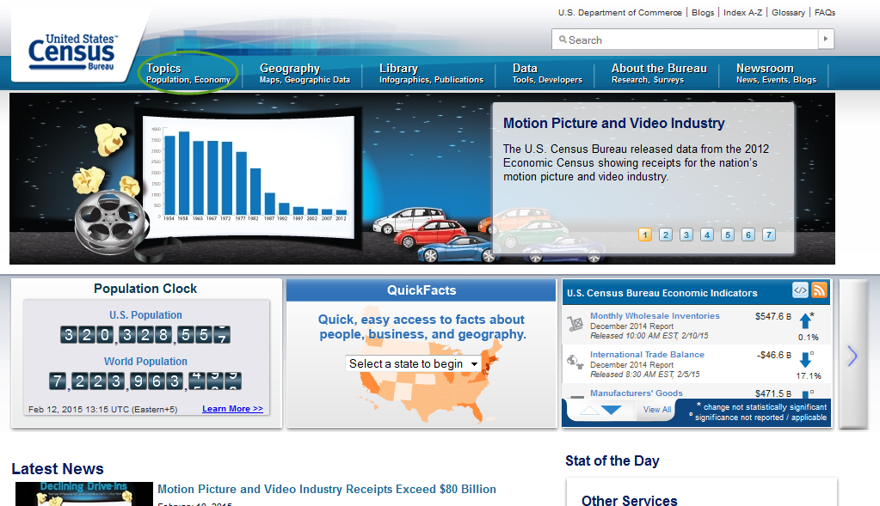
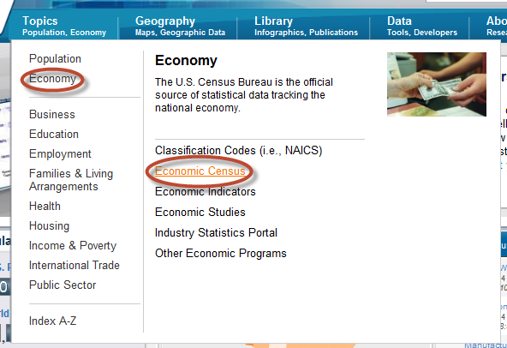
Business.Census.Gov

Slide 6
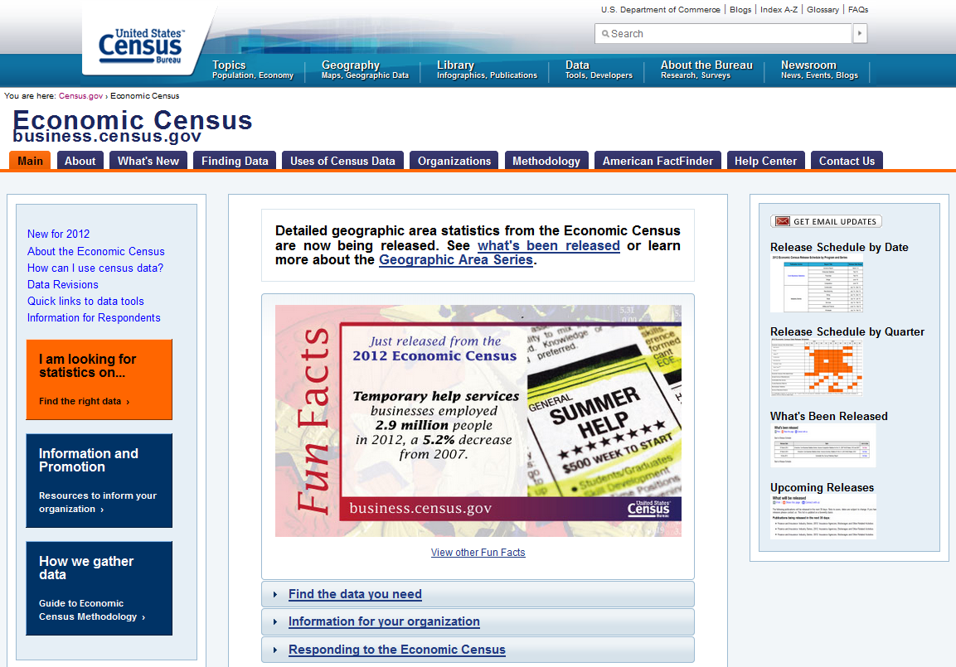
Main Page

Slide 7
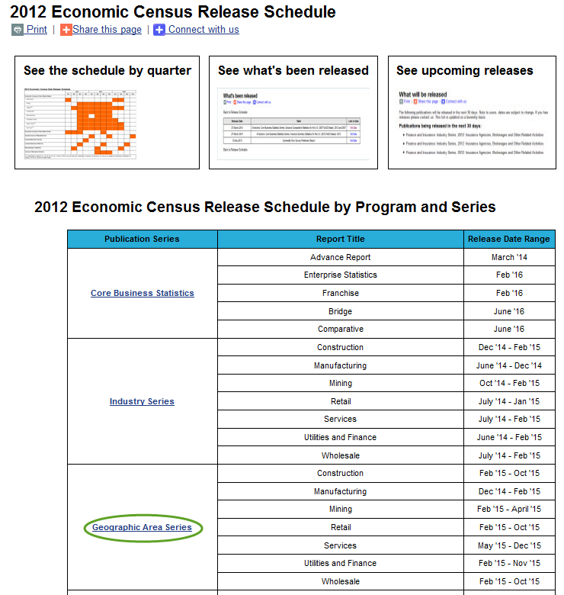
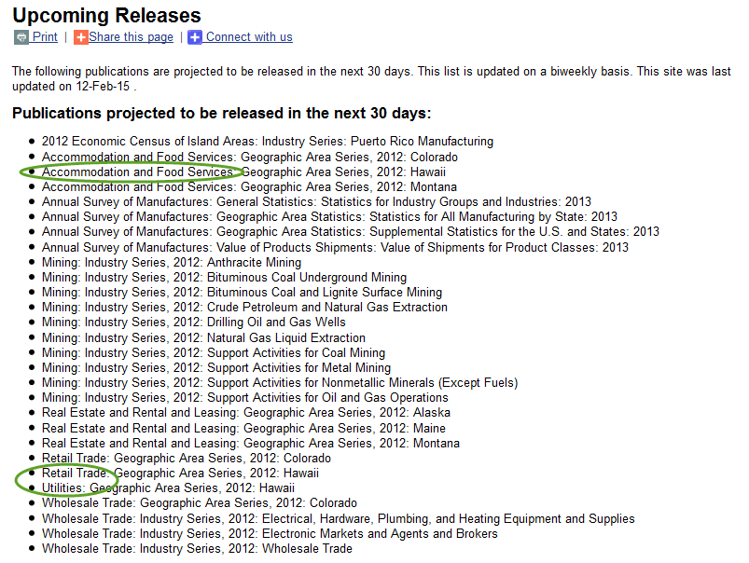
Release Schedule

Slide 8
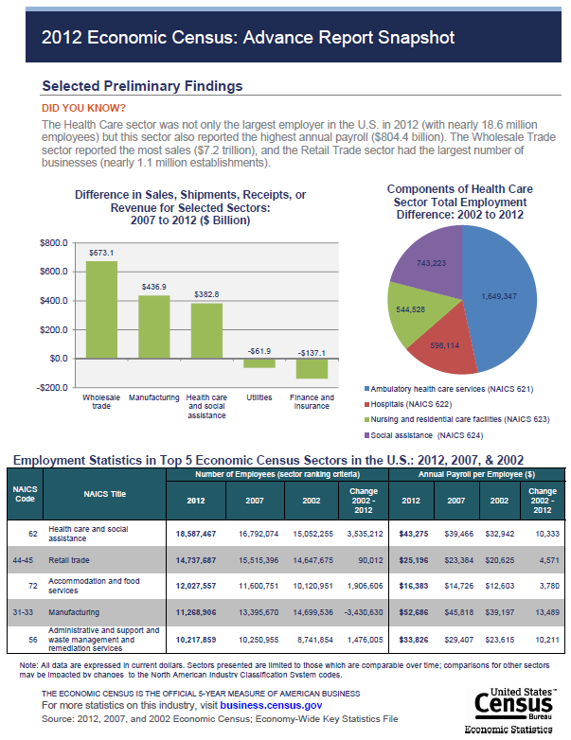
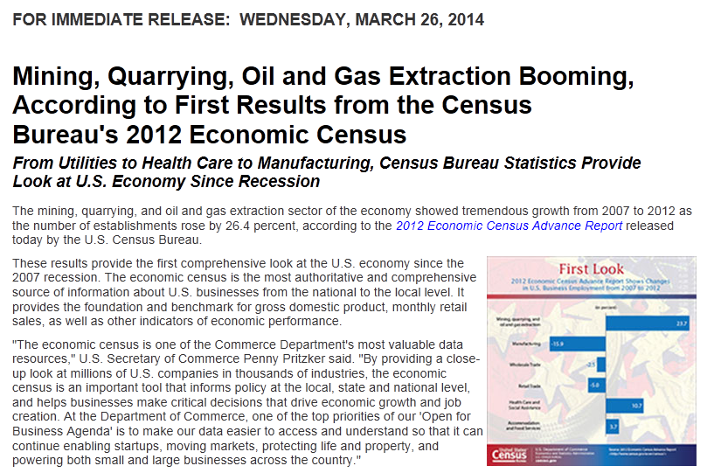
Advance Report
National-level data at 2- and 3-digit NAICS
Released on March 26th, 2014

Slide 9
Industry Series
Started in May 2014 (nearly complete)
National-level data only, but…
More detailed NAICS
Products data
NAICS Changes…

Slide 10

New Industries for the
2012 Economic Census
New and emerging industries
  Breakout of solar, wind, geothermal, and biomass electric power generation from All Other Electric Power Generation (NAICS 221119)
  Stats:
    Number of businesses: 673 in 2011 with 9,058 employees (435 in 2007)
    In 2011: CA - 106, TX – 53, HI – 6

Slide 11
Industry Changes for the
2012 Economic Census
Consolidations due to decrease in number of companies due to:
  General industry decline
  Company consolidation (mergers and acquisitions)
Primarily impacts the manufacturing sector (178 industries)
Stats:
  Steel mills (880 in 2007, 570 in 2011)
  Machine tools (579 to 626 (cutting type) and 292 to 312 (forming type)
Notes:
Manufacturing – Consolidations mirror what is published in the ASM.
2007 NAICS 331111 (Iron & Steel Mills) and 331112 (Electrometalurgical Ferroalloy Product Manufacturing) now combined into 2012 NAICS 331110 (Iron & Steel Mills and Ferroalloy Manufacturing)

Slide 12
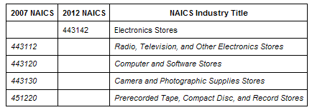
Other Industry Changes
Changes to (and consolidation of ) existing industries due to market change
Primarily impact the Retail and A&F sectors
Stats
  Computer Stores: 12,411 in 2007, 10,292 in 2011
  Camera Stores: 2,049 to 1,115
  Music Stores: 4,496 to 2,379
Notes:
443112: Estabs 29,256 in 2007; 29078 in 2011
443120: Estabs 12,141 in 2007; 10,292 in 2011
443130: Estabs 2,049 in 2007; 1,115 in 2011
451220: Estabs 4,496 in 2007; 2,379 in 2011

Slide 13

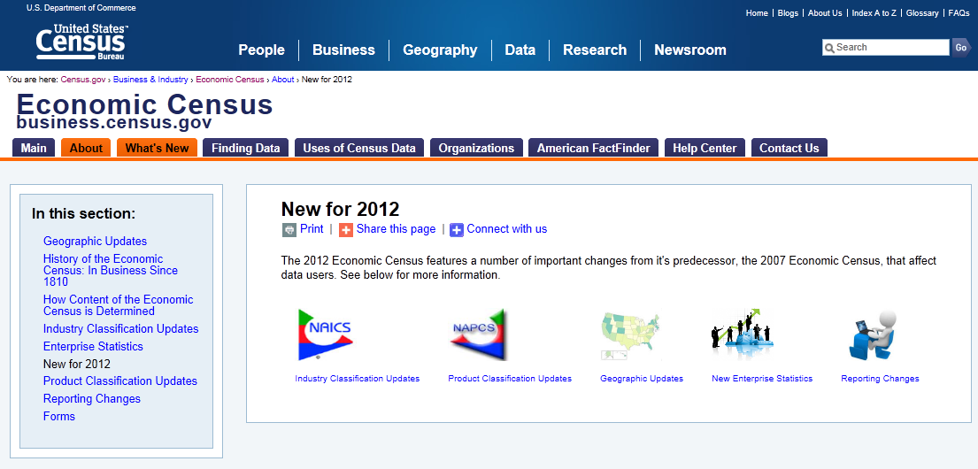
What’s New Page
Notes:
NAICS
NAPCS
Geography
Enterprise Stats
Reporting changes

Slide 14
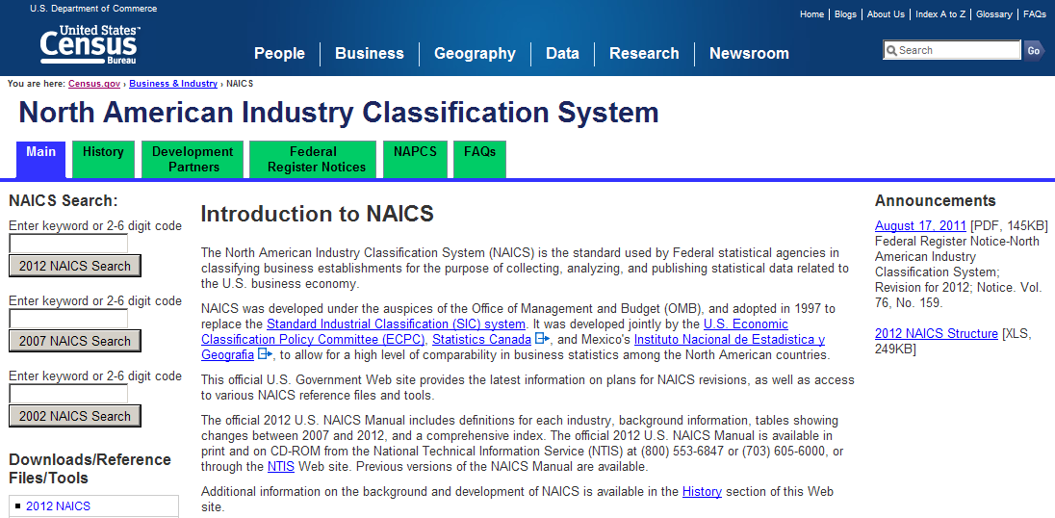
Where Else Can I Go for More Information?
NAICS web site (http://www.census.gov/eos/www/naics/)
  Industry definitions and Concordance tables
  Relationships to other systems
  Federal Register Notices

Slide 15
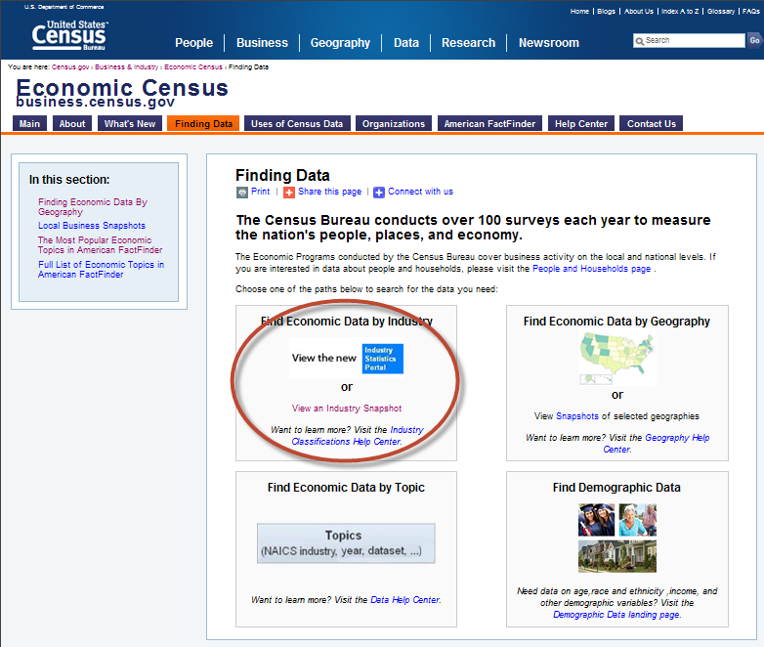
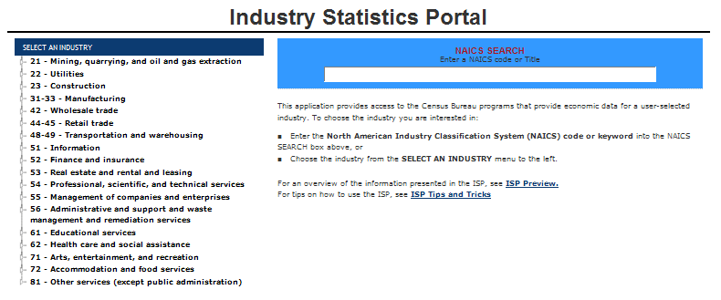
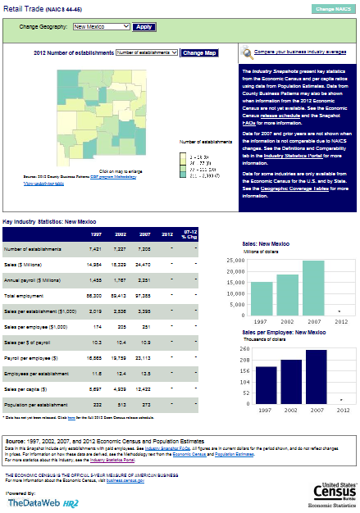
Finding Data Page
A new home for the ISP
… and the Snapshots
(http://www.census.gov/econ/snapshots/index.php)
Notes:
ISP
Geography
Topic
Link to demo data

Slide 16
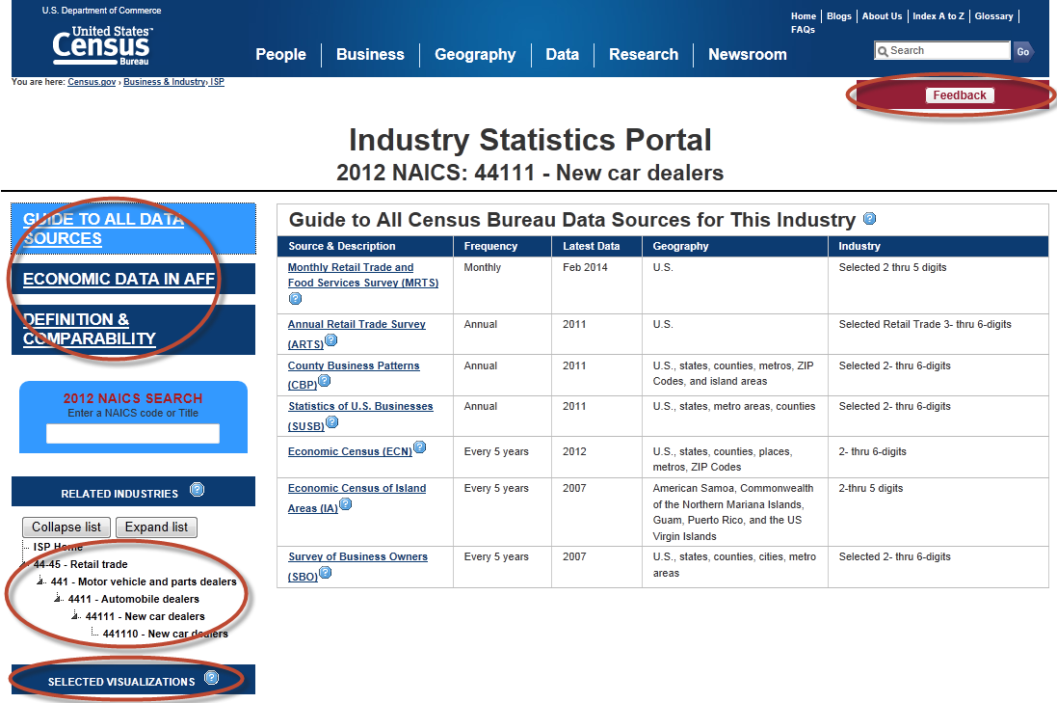
Industry Statistics Portal
Industry Statistics Portal (ISP) (www.census.gov/econ/isp/)
  All data sources for an industry
  Links to AFF
  Industry definitions & comparability back to 1997
Notes:
ISP
Geography
Topic
Link to demo data

Slide 17
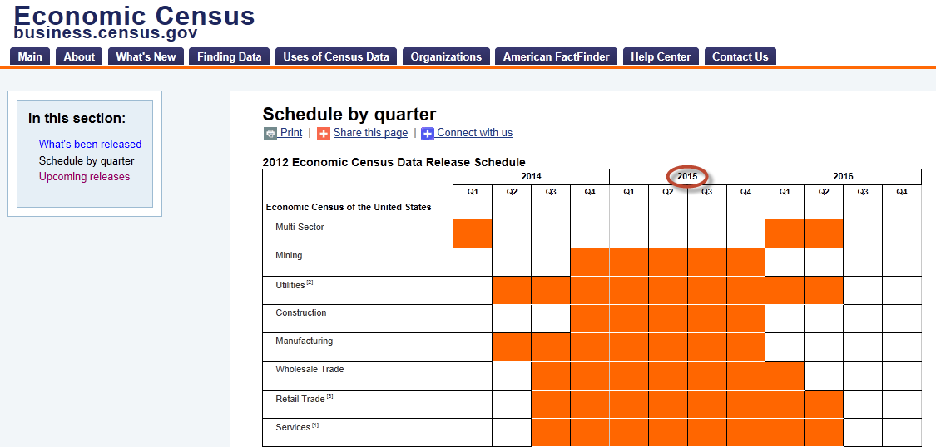
Release Schedule
Geographic Area Series

Slide 18
Geographic Area Series
Kicked off on January 27, 2015 with release of Manufacturing data
National-, state- county-, metro area-, and economic place-level data
Full NAICS detail
LOTS of Changes Coming…

Slide 19
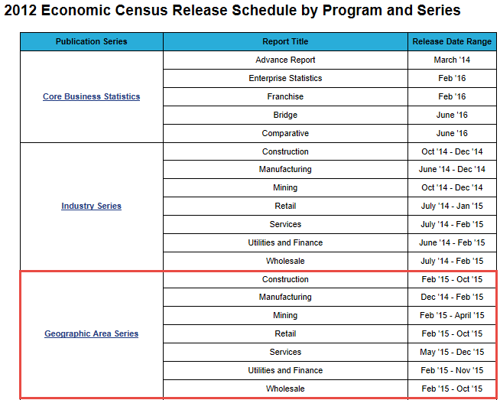
State Release Order
Group | State(s) | Group | State(s)
1 | CO | 10 | DE, DC, MD, NJ, NY, OH, PA, VA, WV
2 | HI | 11 | KY, NC, TN
3 | MT | 12 | IL, IN
4 | AK | 13 | AL, AR, GA, LA, MS, SC
5 | ME | 14 | IA, MO, NE, SD
6 | AZ, NE | 15 | KS, MI, MN, ND, OK, WI
7 | CA | 16 | NM, TX
8 | ID, OR, UT, WA, WY | 17 | FL, US
9 | CT, MA, NH, RI, VT

Slide 20
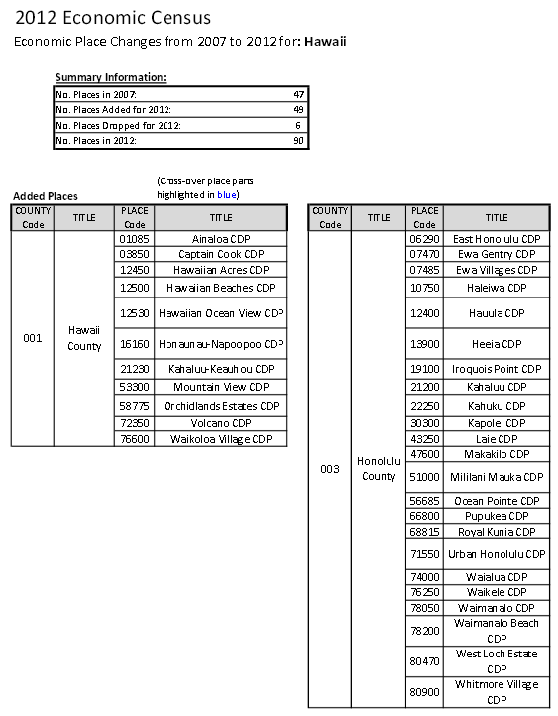
New Places
2007 EC cutoff: 5,000+ pop or jobs
2012 EC cutoff: 2,500+ pop or jobs
Results in nearly 5,000 new places published for 2012
49 added for HI

Slide 21
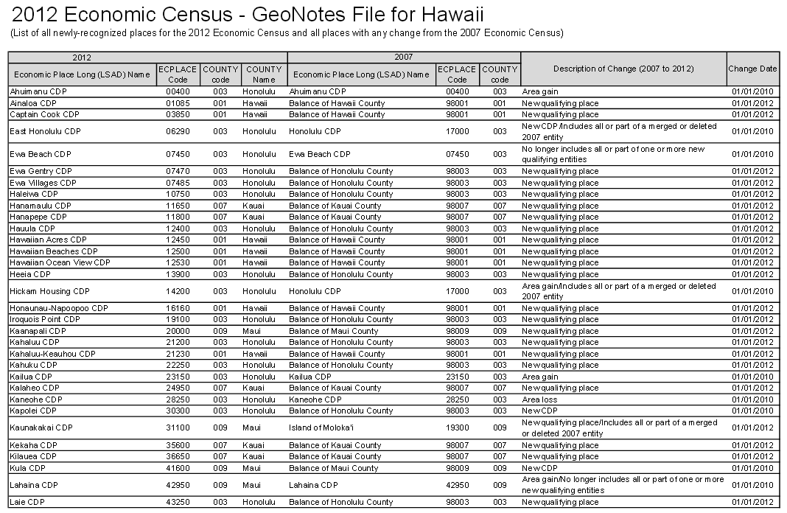
Place Changes
Adds / Drops
Boundary Changes
New Incorporations / Unincorporations

Slide 22
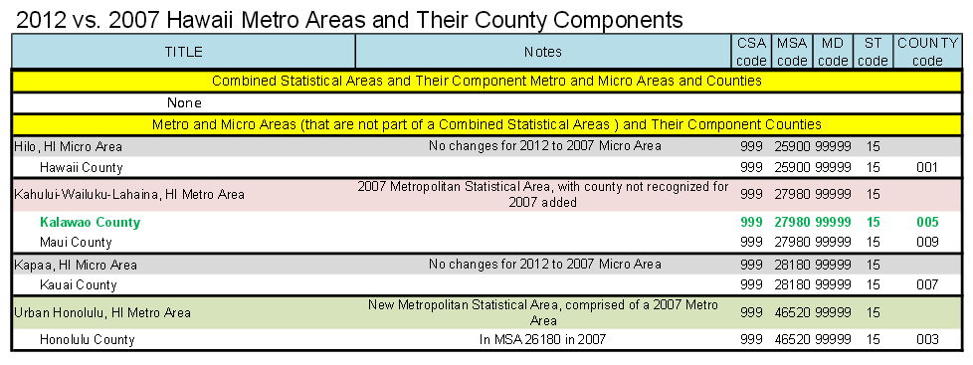
New Metros
2007: metro areas as of Dec. 2006
2012: metros after 2010 Decennial
156 new or changed metros
  In HI – 1 new, 1 changed, 2 unchanged

Slide 23
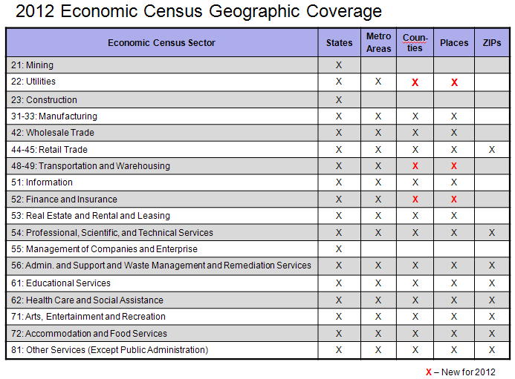
More Sectors

Slide 24
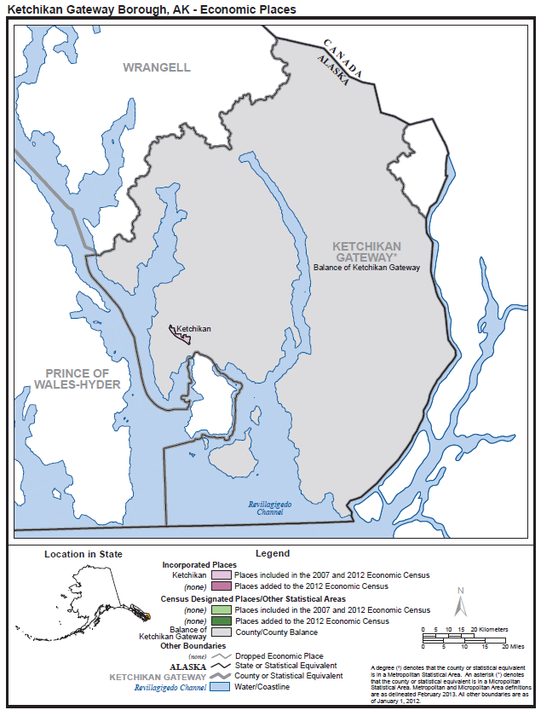
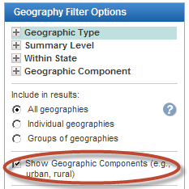
Other Geographic Changes
No pub cutoffs
6 New Counties in AK
Planning Areas in PR
Geographic Components
  Offshore Areas
  “Statewide” Areas
  Non-Metro Areas

Slide 25
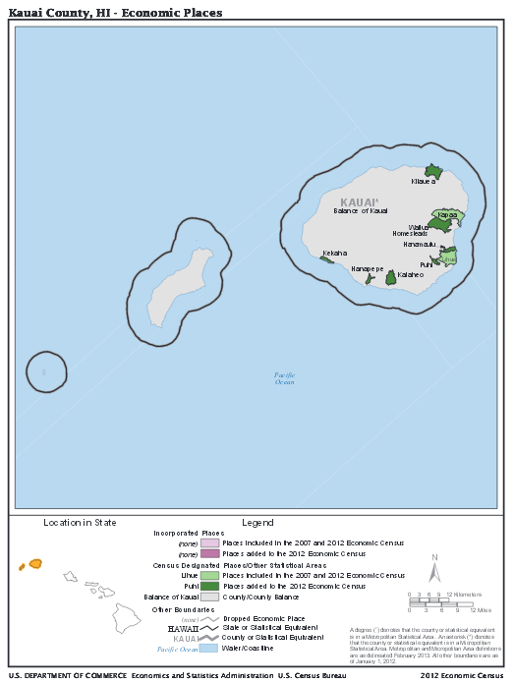
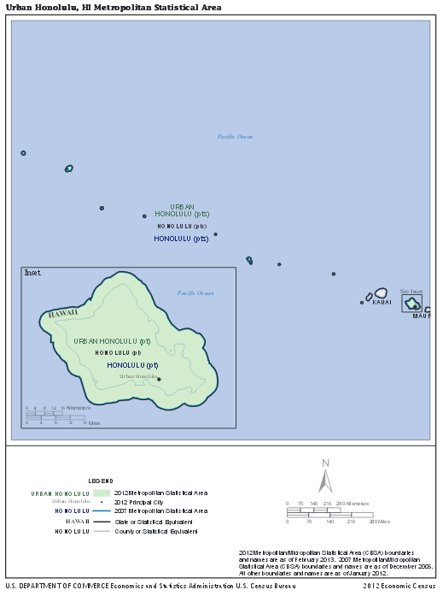
Reference Maps

Slide 26
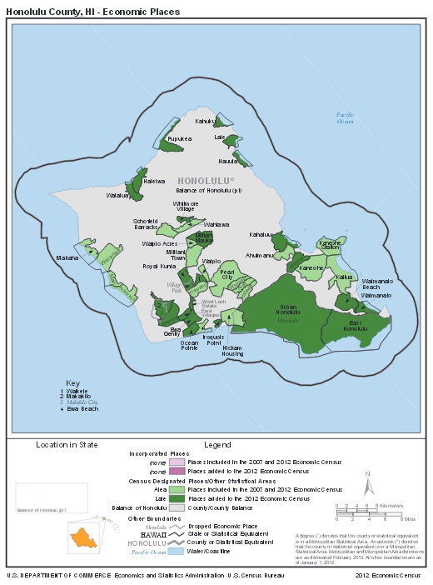
Reference Maps

Slide 27
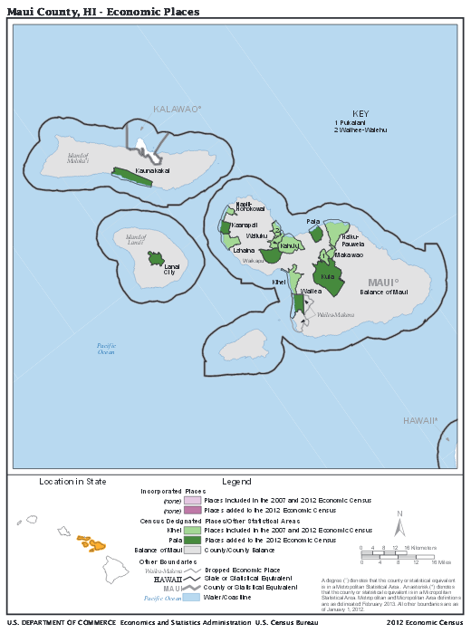
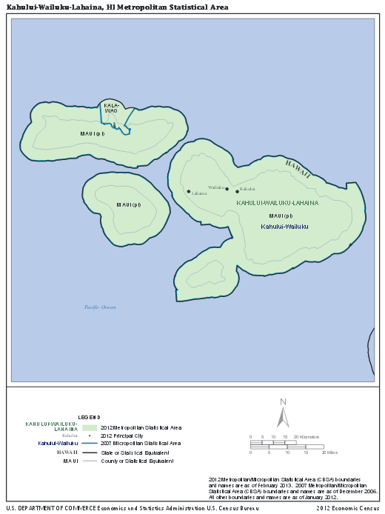
Reference Maps

Slide 28
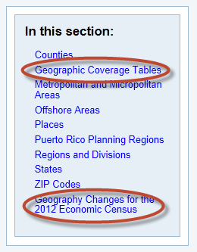
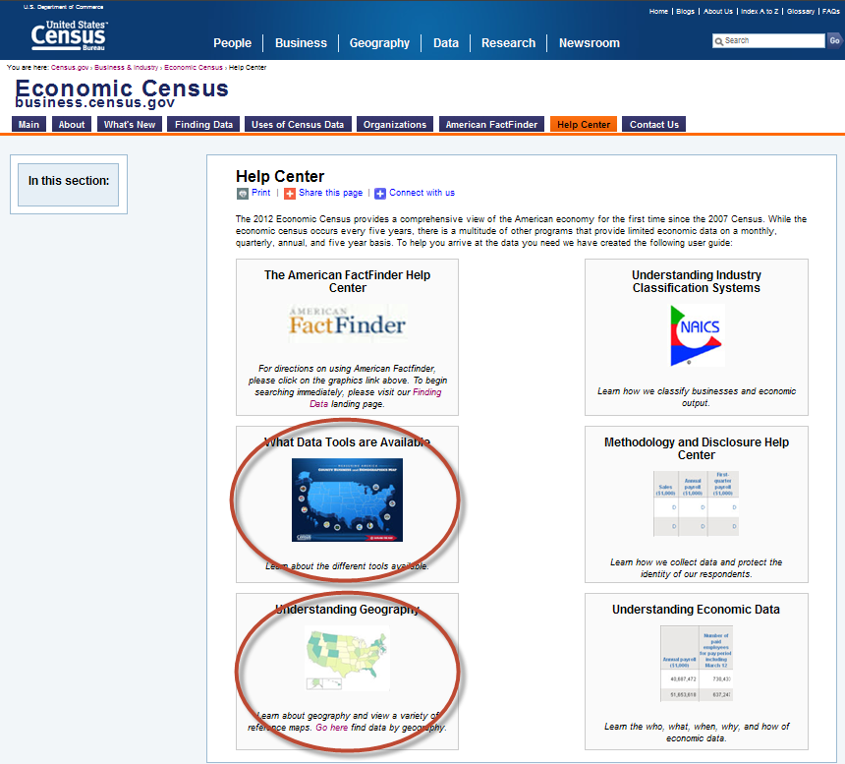
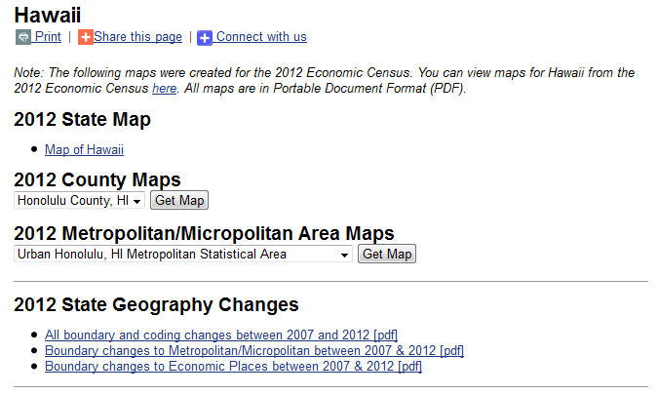
Help Center Page
2012 EC Geo Reference info
Notes:
AFF Help Content
NAICS help
Tools
Methodology
Geography
Econ data help

Slide 29
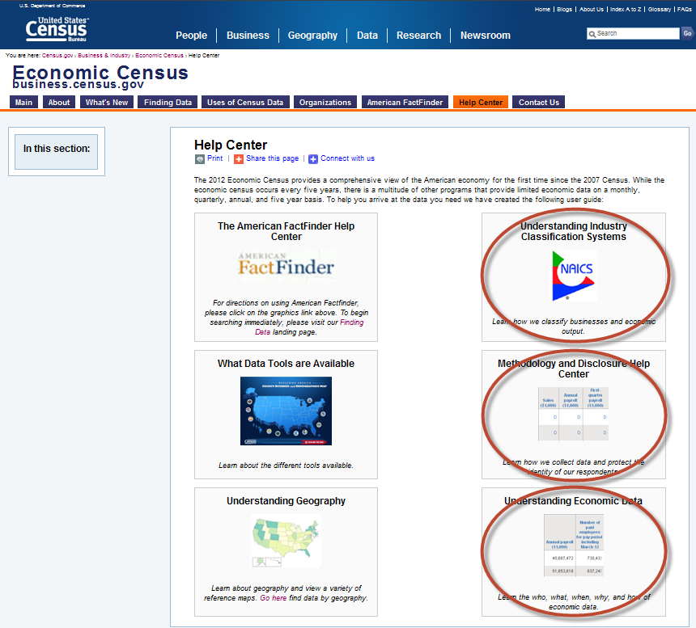
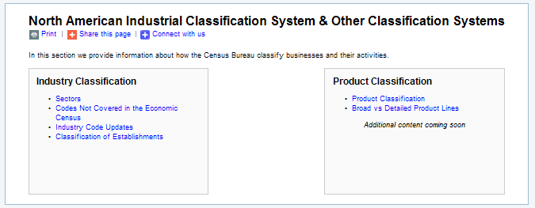
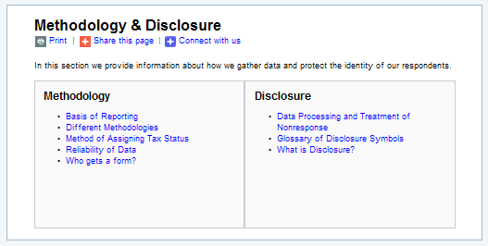
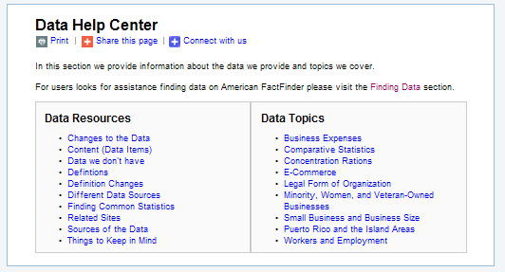
Help Center Page (cont.)
Comprehensive descriptions
Notes:
AFF Help Content
NAICS help
Tools
Methodology
Geography
Econ data help

Slide 30
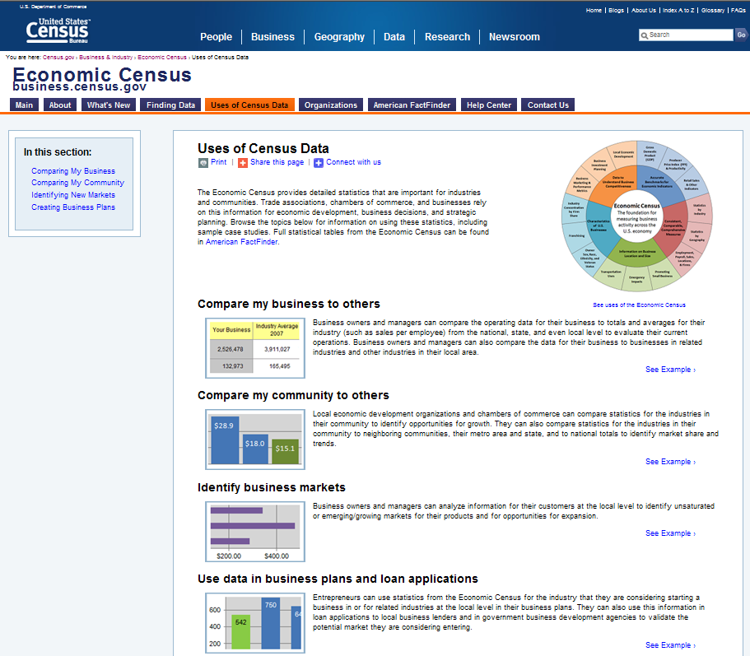
Uses of Census Data Page
Help us identify real-life examples…
Notes:
4 high-level use cases
Links to examples
More coming – please help!

Slide 31
Census-Related Programs
Commodity Flow Survey (CFS) - Selected national- and finer-level data on the movement of products across the U.S. by mode of transportation (plus other breakouts). (http://www.census.gov/econ/cfs/)
Economic Census of Island Areas – Selected industry, product, and other data for American Samoa, Guam, the Northern Mariana Islands, Puerto Rico, and the U.S. Virgin Islands. (http://www.census.gov/econ/islandareas/)
Survey of Business Owners (SBO) – Selected national- and finer-level industry data for women- and minority-owned businesses and the characteristics of all businesses and their owners. (http://www.census.gov/econ/sbo/)

Slide 32
Current Economic Surveys
Other Annual and related economic programs
  Retail e-Commerce Sales (http://www.census.gov/econ/estats/index.html)
  Annual Capital Expenditures Survey (http://www.census.gov/econ/aces/index.html)
  Information and Communication Technology Survey (http://www.census.gov/econ/ict/index.html)
  Statistics of U.S. Businesses (http://www.census.gov/econ/susb/index.html)
  Foreign Trade (http://www.census.gov/foreign-trade/)
  Census of Governments (http://www.census.gov/govs/)

Slide 33
Statistics About Governments
Main purposes
  Provide economic statistics about governments at the federal, state, and local area levels
  Serve as public-sector counterpart to private sector
  Track activity of governments over time
Response is voluntary
Virtually no confidentiality restriction
Notes:
Provide Information on the Structure, Function, Finances, Taxation, Employment, and Public Employee Retirement Systems of our Nation's Over 90,000 State and Local Governments
Provide data on revenue by source, expenditure by character and function, indebtedness by term, cash and investments, employment, public employee pensions
Data are Publicly Available and Used by Other Federal Agencies, State and Local Legislators, Researchers, Businesses, and Individuals
Key difference between public sector surveys and private economic counterparts
-voluntary response
-data collected are publicly available- no confidentiality restriction
*we can release data at the individual unit of government

Slide 34
Core Programs Content
Organization and Structure – Governments by type
Government Employment - Full-time employees, Full-time gross payroll, Part-time employees, Part-time gross payroll, Computed FTE
Government Finances - Revenue by type, Expenditure by character object & function, Debt term, Cash and Securities by type of holding
Notes:
Judicial and Legal, Police Officers, Corrections, Highways, Air Transportation ,
Water Transport and Terminals, Public Welfare, Health and Hospitals, Solid Waste Management,
Sewerage, Parks and Recreation, Housing and Community Development, Natural Resources
Water Supply, Electric Power, Gas Supply, Transit, Education, Local Libraries, State Liquor Stores
Government Employment (115 variables)
Full-time employees (23 functions)
Full-time gross payroll (23 functions)
Part-time employees (23 functions)
Part-time gross payroll (23 functions)
Computed FTE (23 functions)

Slide 35
Types of
Governments
90,106
Government Organizations
90,056
Local Governments
38,910
General Purpose Governments
51,146
Special Purpose Governments
50
State Governments
3,031
Counties
19,519
Cities
16,360
Townships
38,266
Special Districts
12,880
Independent School Districts
Source: U.S. Census Bureau, 2012 Census of Governments: Organization

Slide 36
Composition of Local Governments
1952
1982
2012
116,756
81,780
90,056
School Districts
58%
Special Districts
34%
Special Districts
42%
Total Number of Local Governments
Cities
23%
Cities
22%
Townships
15%
Townships
20%
Townships
18%
Cities
14%
School Districts
18%
School Districts
14%
Special Districts
11%
Counties
3%
Counties
4%
Counties
3%
Source: 1952, 1982, & 2012 Census of Governments:

Slide 37
Virginia vs. Maryland, Illinois, and Connecticut
Counts of Governments
 | Virginia | Maryland | Illinois | Connecticut
Counties | 95 | 23 | 102 | 0
Cities | 229 | 157 | 1,298 | 30
Townships | 0 | 0 | 1,431 | 149
Special Districts | 193 | 167 | 3,227 | 447
School Districts | 1 | 0 | 905 | 17
Total | 518 | 347 | 6,963 | 643
Source: U.S. Census Bureau, 2012 Census of Governments
Notes:
To provide an example of how different each state is I selected a few states that would display their breakdown of governments

Slide 38
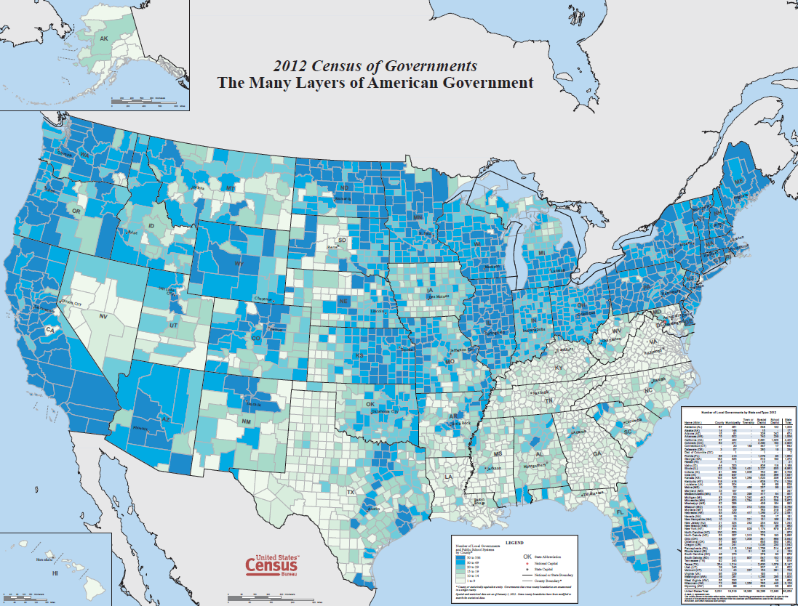
Notes:
In this map the darker shaded regions indicate more governments in those county areas than in the lighter-shaded regions. So in the southern states like Maryland and Virginia, the county government provides a wide array of services, such as education. In states with deeper blue shading, some of those services are provided by other types of local governments, such as school districts, townships, and special districts.
Government
Airport authorities
Cities
Counties
Sanitary districts
States
Non-Government
Homeowners’ associations
Most charter schools
Also notice that New York City here is shaded very lightly. The city government of New York provides services that in the surrounding areas would be provided by multiple governments.
Governments were organized in each state according to the historical circumstances of that state, making every state different in their organization and structure.
The US Constitution does not dictate to states how their services ought to be provided or how their local governments are structured. So we will see variations like electric power provided by special district in NE, private corporate in MI, and general purpose in IN etc.
The term “government” does not equal “geography” as governments can layer on top of each other where as geographies have defined boundaries and governments can and often cross geographic boundaries.

Slide 39
Sources of Tax Revenue
Percent Distribution of State Government Tax Revenue
Percent Distribution of State Government Tax Revenue
 | Total % | Sales Total | General Sales | Selective Sales | License Taxes Total | Income Taxes Total | Individual Income | Corporation Income | All Other Taxes Total | Property Taxes | Other Taxes
U.S. Average | 100 | 46.4 | 30.1 | 16.4 | 6.5 | 41.9 | 36.5 | 5.3 | 5 .1 | 1.5 | 3.6
Alaska | 100 | 4.9 | X | 4.9 | 2.6 | 12.3 | X | 12.3 | 80.2 | 1.9 | 78.3
Delaware | 100 | 14.6 | X | 14.6 | 37.6 | 43.0 | 33.8 | 9.3 | 4.8 | X | 4.8
Florida | 100 | 82.9 | 58.8 | 24.1 | 5.6 | 5.9 | X | 5.9 | 5.6 | <.01 | 5.6
Maryland | 100 | 40.6 | 22.7 | 17.8 | 4.4 | 47.7 | 42.5 | 5.3 | 7.3 | 4.1 | 3.1
Virginia | 100 | 32.3 | 19.3 | 12.9 | 4.2 | 60.8 | 56.8 | 4.0 | 2.7 | .2 | 2.5
Source: U.S. Census Bureau, 2013 Survey of State Government Tax Collections

Slide 40
Governments as Employers
 | Fairfax County | Prince Georges County
Total Employees | 49,681 | 29,936
Elementary and Secondary School Employees | 34,250 | 20,441
Police Officers | 1356 | 1617
Total Payroll | $205,559,497 | $134,026,844
Elementary and Secondary School Payroll | $129,649,536 | $88,468,711
Police Officers Payroll | $10,146,636 | $10,007,933

Slide 41
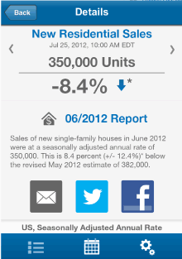
Other Economic Data Tools
QuickFacts
  Data from CBP, Nonemployers, SBO, EC, & Building Permits (and more coming soon)
Interactive Map
  Data from CBP and Pop Estimates
America’s Economy Mobile App
  Data from the Economic Indicators
Business Development Tool… coming soon…

Slide 42
Summary
Our new business.census.gov site has a lot of useful materials for you and your users
  Just a sip of data has been released so far
  Lots more coming
Stay tuned for other new offerings
Visit business.census.gov and promote use of Census demo & econ data

Slide 43

Questions

Slide 44
Mahalo!
Contact me at: andrew.w.hait@census.gov
(301)763-6747

