Slide 1
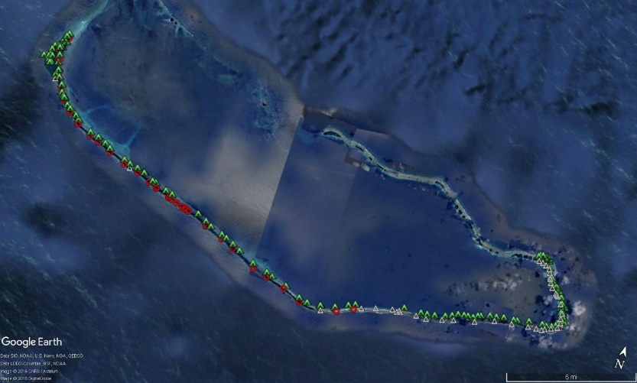
Modernizing the National Spatial Reference System
Overview
&
Burning Questions - Answered
Edward E. Carlson
NOAA’s National Geodetic Survey
Pacific Region Geodetic Advisor
November 13, 2019

Slide 2



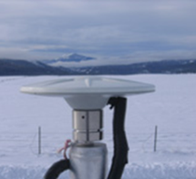

U.S. Department of Commerce
National Oceanic & Atmospheric Administration
National Geodetic Survey
Mission: To define, maintain & provide access to the
National Spatial Reference System (NSRS)
to meet our Nation’s economic, social & environmental needs
Aviation
Navigation
Satellite
Operations
Surveying
and Mapping
CORS
Precision Agriculture
Notes:
- NSRS benefit to the nation = $2.5B/year
est. 300K precision GPS users worldwide (2008); ¼ in US
- Very exciting to us at NGS to see how it has evolved over the years – now cm-accuracy capability / tracking with time

Slide 3
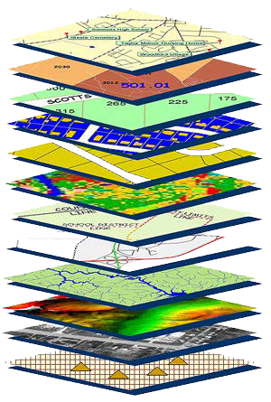
Role of National Spatial Reference System
The NSRS is the official coordinate system for all geospatial work done by the U.S. non-military federal government. (Latitudes, Longitudes, Heights)
A geodetic datum is an abstract coordinate system with a reference surface (such as sea level) that serves to provide known locations to begin surveys and create maps.
Geodetic control provides a common reference system for establishing coordinates for all geographic data on geodetic datum.
All National Spatial Data Infrastructure framework data and users' applications data require geodetic control to accurately register spatial data.

Slide 4
These are part of the NSRS*
Horizontal Datums and Geometric Reference Frames | Vertical Datums | Great Lakes Datums | Geoid Models | Transformations and Conversions
USSD | NGVD 29 | IGLD55 | GEOID90 | NADCON
NAD 27 | NAVD 88 | IGLD85 | GEOID93 | VERTCON
NAD 83 | PRVD02 |  | ALASKA94
 | ASVD02 |  | GEOID96 | SPCS 27
 | NMVD03 |  | GEOID99 | SPCS 83
 | GUVD04 |  | GEOID03 | UTMs
 | VIVD09 |  | GEOID06
 |  |  | GEOID09
 |  |  | GEOID12(A,B)
*This not a complete list.

Slide 5
These are not part of the NSRS*
Horizontal Datums and Geometric Reference Frames | Vertical Datums | Great Lakes Datums | Geoid Models | Transformations and Conversions
WGS 84 | IHRS |  | OSU91A | CORPSCON
ITRF |  |  | EGM96 | Appendix B.6 of DMA TR 8350.2 (WGS 84)
IGS |  |  | EGM2008 | Oregon Coordinate Reference System
 |  |  |  | The Kansas Regional Coordinate System
*This is not a complete list.

Slide 6
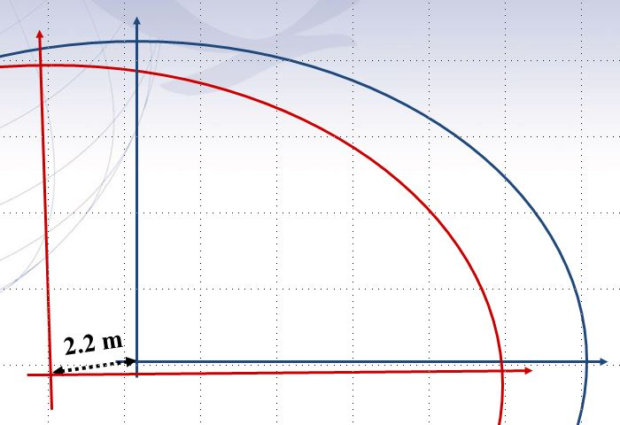

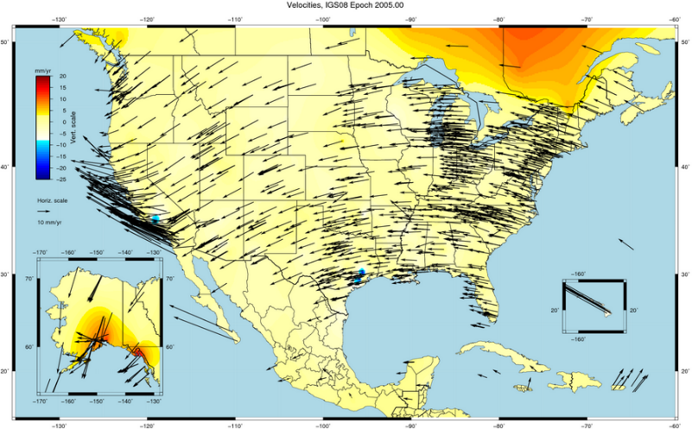
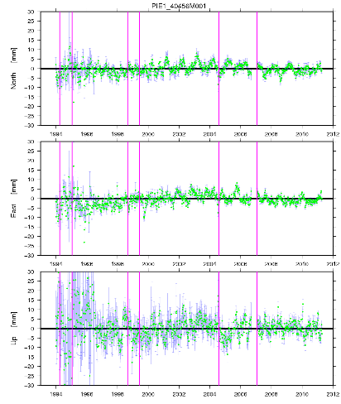
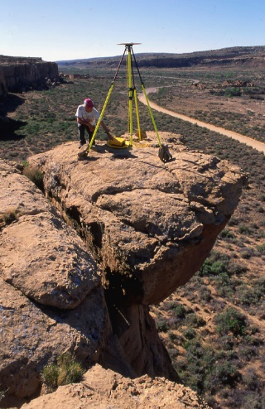
NAD83 Shortcomings
2.2 m offset – NAD83 vs.
International Terrestrial Reference Frame (ITRF) [~ International GNSS Service (IGS)]
World Geodetic System 1984 (WGS84)
CORS <> passive network “disconnect”
ITRF/WGS84
NAD83
vs.

Slide 7
Why replace NAD 83 and Vertical Datums?
Main driver: Global Navigation Satellite System (GNSS)
ACCESS!
  GNSS equipment is fast, inexpensive, reliable (and improving)
  Reduces reliance on finding survey control (“bench marks”)
ACCURACY!
  Insensitive to distance-dependent errors; reliable
  Immune to bench mark instability (referenced to CORS)
CONSISTENCY!
  Eliminates systematic errors in current datums
  Aligned with global reference frames
  Integrated system for both positions and heights (“elevations”)

Slide 8

The National Geodetic Survey
Ten-Year Plan
Support the users of the National
Spatial Reference System.
Modernize and improve the National
Spatial Reference System.
( i.e., Replace NAD83 & NAVD88 )
Expand the National Spatial Reference
System stakeholder base through
partnerships, education, and outreach.
Develop and enable a workforce with
a supportive environment.
Improve organizational and administrative functionality.
Notes:
NGS Ten-Year Strategic Plan, 2013
The NGS Ten-Year Plan was adopted at the beginning of 2013, including four major goals and an enterprise goal:
Goal 1: Support the Users of the National Spatial Reference System.
Goal 2: Modernize and Improve the National Spatial Reference System.
Goal 3: Expand the National Spatial Reference System Stakeholder Base through Partnerships, Education and Outreach.
Goal 4: Develop and Enable a Workforce with a Supportive Environment.
Enterprise Goal: Improve Organizational and Administrative Functionality.

Slide 9

Ten-Year Strategic Plan - Goals
  By 2022, reduce all definitional & access-related errors in geometric reference frame to 1 cm when using ≤30 minutes of GNSS data
  “Replace NAD83”
  (NAD83 = North American Datum 1983)
  By 2022, reduce all definitional & access-related errors in orthometric heights in geopotential datum to 2 cm when using ≤30 minutes of GNSS data
  “Replace NAVD88”
  (NAVD88 = North American Vertical Datum 1988)

Slide 10
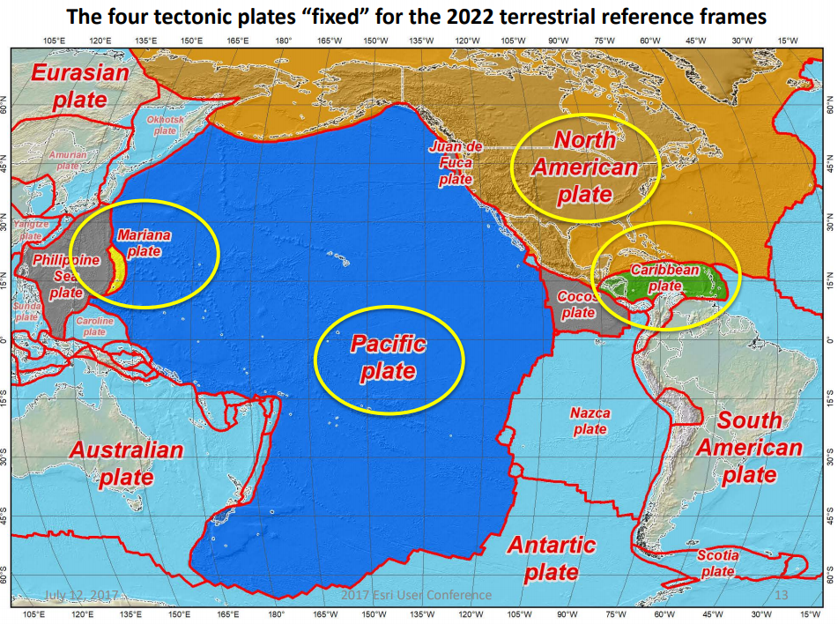
2022 Datum Tectonic Plates
In 2022, the entire National Spatial Reference System (NSRS) will be modernized and will contain four new reference frames:
  North American Terrestrial Reference Frame of 2022 (NATRF2022)
  Pacific Terrestrial Reference Frame of 2022 (PATRF2022)
  Mariana Terrestrial Reference Frame of (MATRF2022)
  Caribbean Terrestrial Reference Frame of 2022 (CATRF2022)

Slide 11
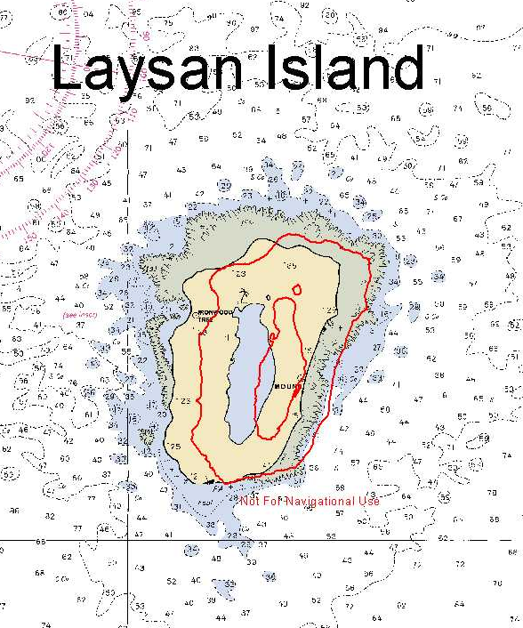
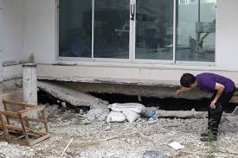
All coordinates and heights “Will change”!!!

Slide 12
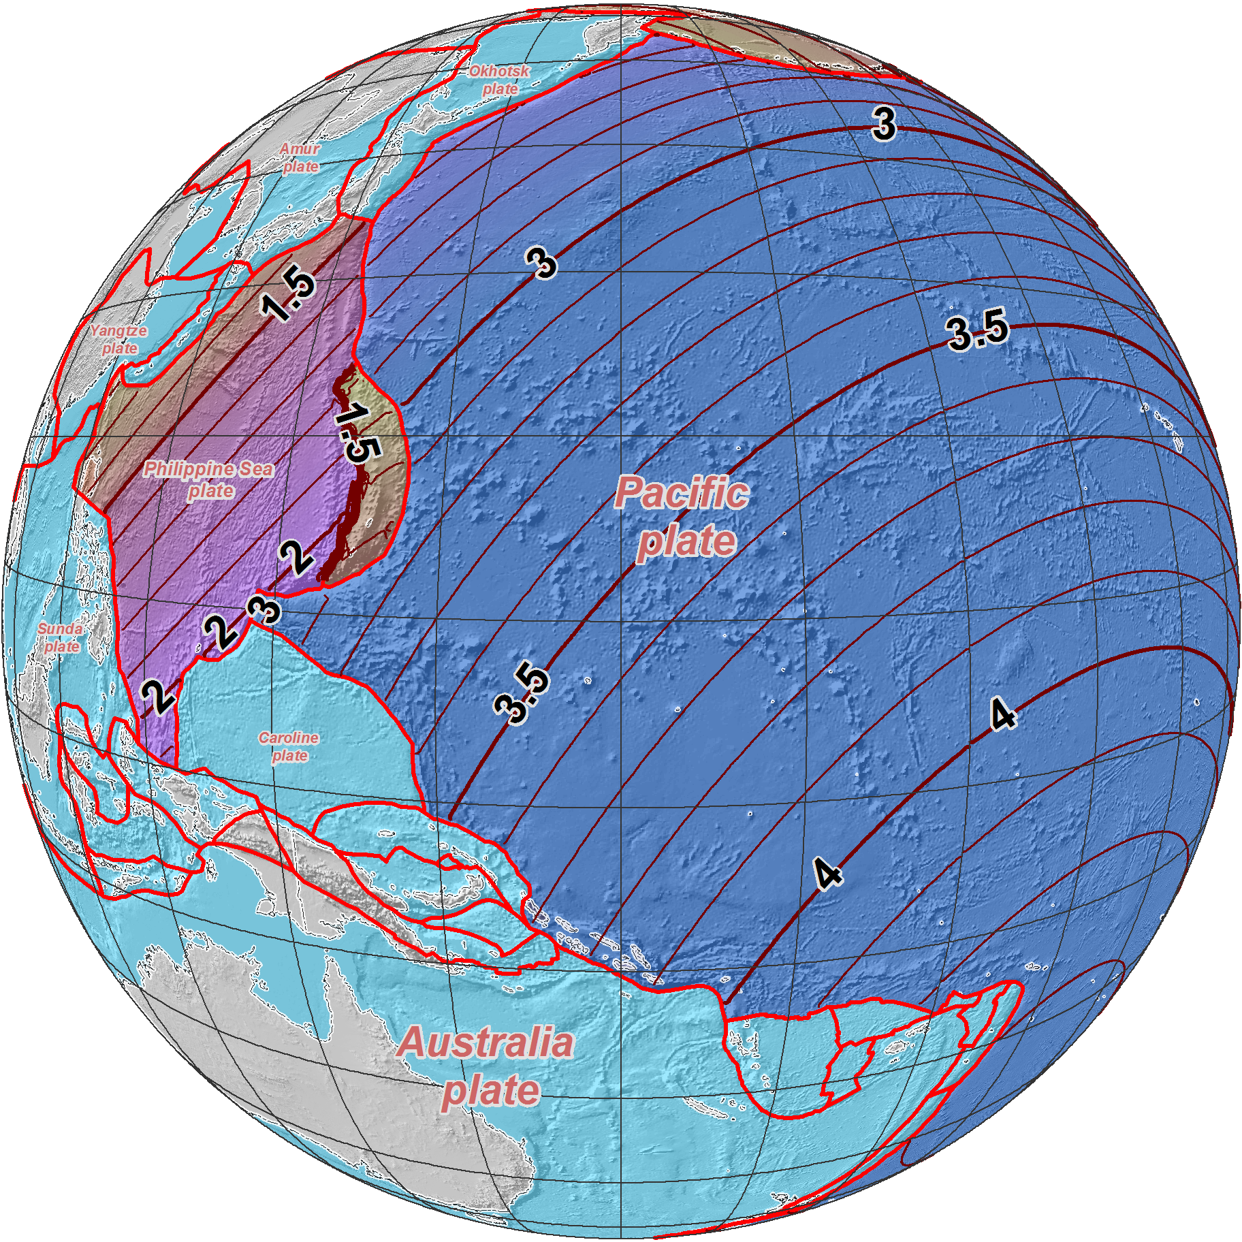
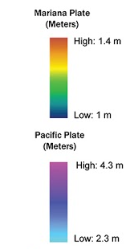
NAD 83 (2011/PA11/MA11) epoch 2010.00 →
2022 Terrestrial
Reference Frames
Horizontal change at epoch 2022.00
(contours in meters)
MATRF2022
PATRF2022

Slide 13
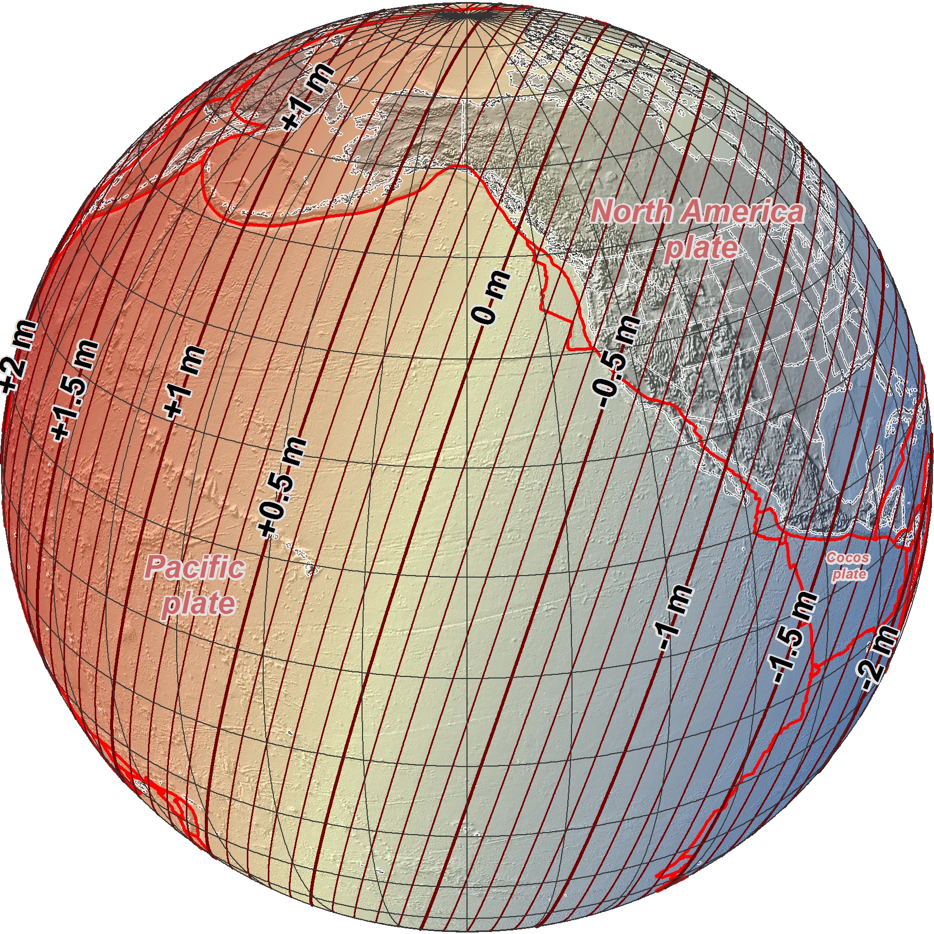
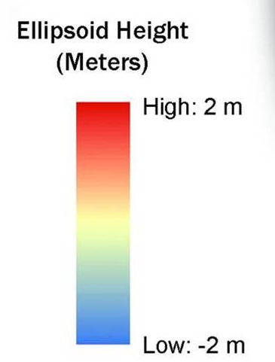
NAD 83 (2011/PA11/MA11) epoch 2010.00 →
2022 Terrestrial
Reference Frames
Change in ellipsoid heights at epoch 2022.00
(contours in meters)

Slide 14
ELLIPSOID - GEOID RELATIONSHIP
H = Orthometric Height (Local Mean Sea Level)
h = Ellipsoidal Height (NAD 83)
N = Geoid Height (GEOID12A, EGM08)
H = h - N
H
TOPOGRAPHIC SURFACE
h
N
Geoid12A, EGM08
Ellipsoid
GRS80
Geoid
Geoid = Equipotential (level) surface, which defines best, in a least-square sense, the global mean sea level.

Slide 15
Problems in Different Vertical Datums
Earth’s
Surface
H (LMSL)
H (GPS-OH)
Leveled reference level
GPS-OH
HNL BEN
Geoid12A
5.894 ~ 21.090 – (+15.196)m
5.894 ~ 5.320m (LMSL)
Difference ~ 0.574m or 1.87ft
Errors : ~50 cm average,
100 cm CONUS tilt,
50/70 cm in Hawaii
1-2 meters average in Alaska
Notes:
This slide shows what NGS now knows about the error in NAVD 88 itself. Using a continental geoid computed from the GRACE satellite, a bias and tilt in NAVD 88 has been computed using GPS derived ellipsoid heights on NAVD 88 bench marks. These are now known errors that exist in all NAVD 88 bench marks. This datum realization error, relative to the geoid, is over and above the errors from marks moving.

Slide 16
“Vertical”: Out with the old, in with the new
  The Old:
  NAVD 88
  PRVD 02
  VIVD09
  ASVD02
  NMVD03
  GUVD04
  IGLD 85
  IGSN71
  GEOID12B
  DEFLEC12B
Orthometric
Heights
  The New:
  The North American-Pacific Geopotential Datum of 2022 (NAPGD2022)
  Will include GEOID2022
  DEFLEC2022
  SGRAV2022
one vertical datum
pole-to-equator
Normal
Orthometric
Heights
Dynamic
Heights
Gravity
Geoid Heights
Deflections of
the Vertical

Slide 17

Replacing NAVD88, ASVD02, NMVD03, GUVD04
Changing from a leveling-based to a geoid/GNSS-based (gravimetric) vertical datum
Biggest requirement: An updated,
accurate, nationwide gravity survey
  Airborne
  GRAV-D!
    Gravity for the Redefinition of the
    American Vertical Datum
Notes:
The way of the future will be to get access to orthometric heights by removing a geoid model from GNSS-determined ellipsoid heights.

Slide 18
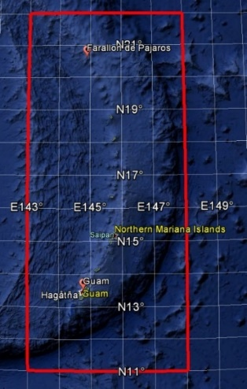
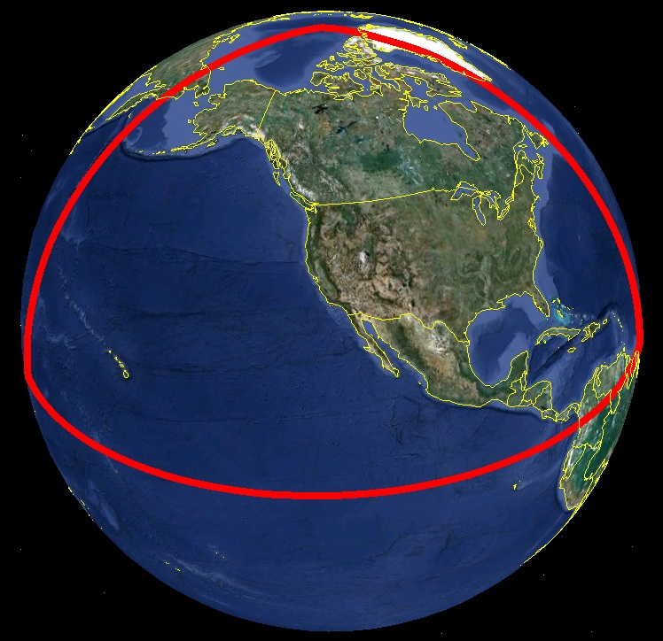
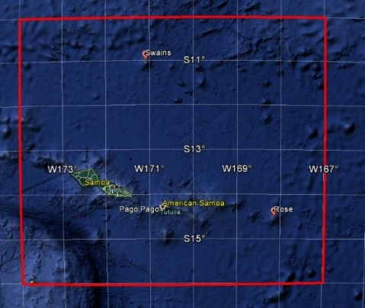
Extent of NAPGD2022 gravimetric geoid model
Guam and Northern Marianas Islands
American Samoa

Slide 19
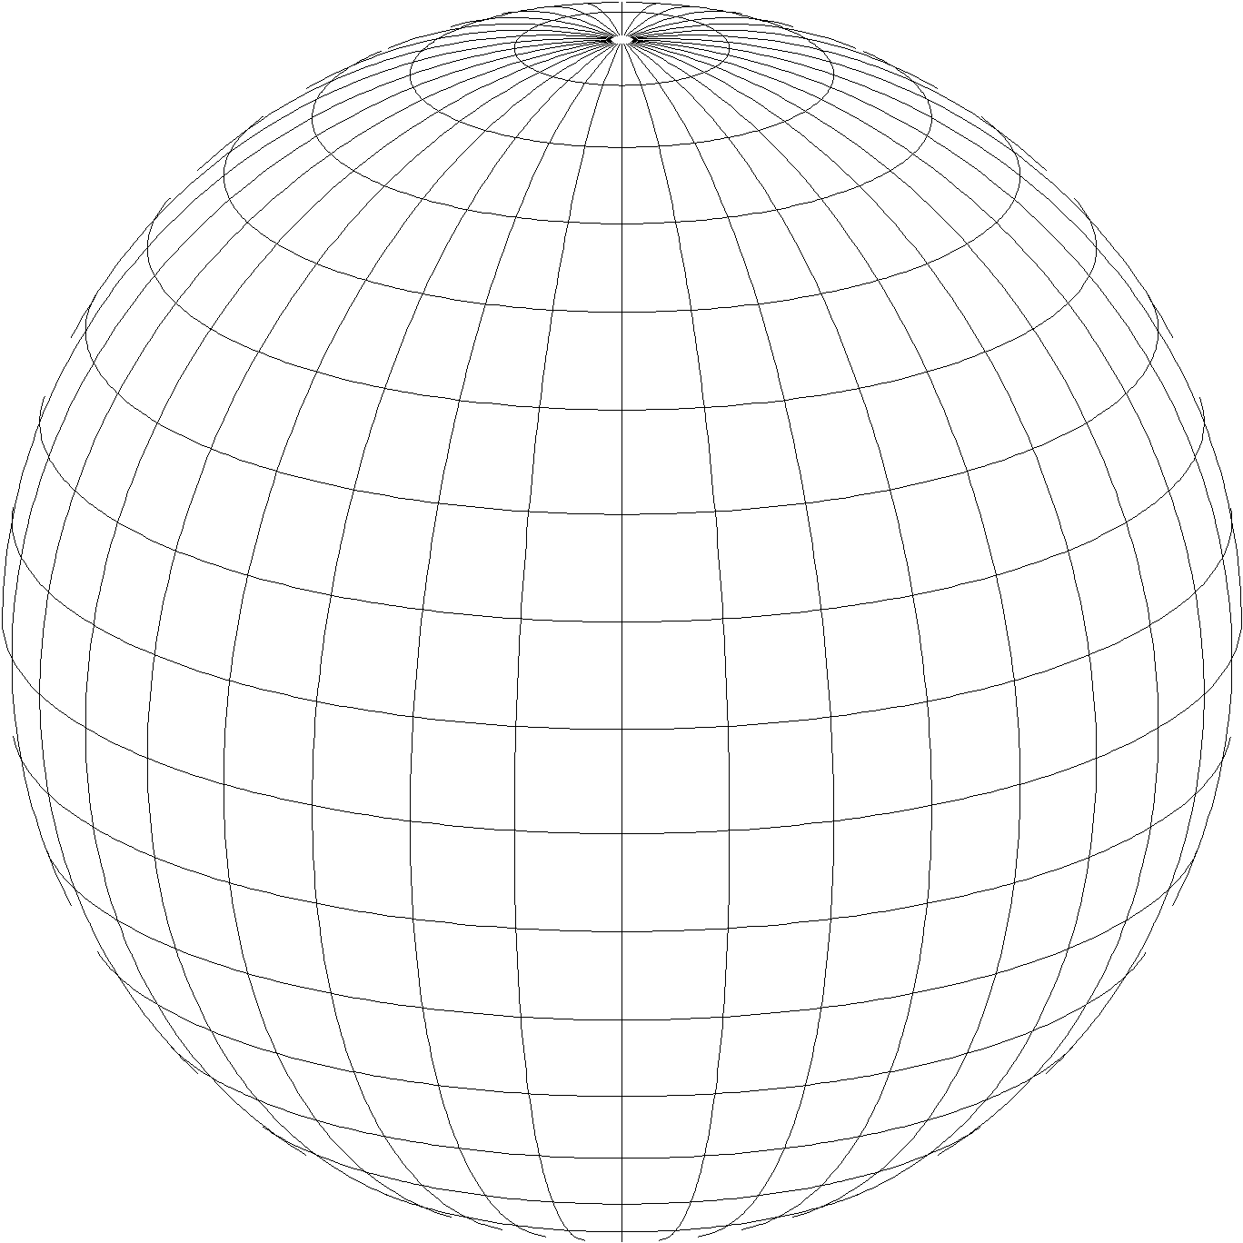
A New State Plane for 2022
State Plane Coordinate System of 2022 (SPCS2022)
  Referenced to 2022 Terrestrial Reference Frames (TRFs)
  Based on same reference ellipsoid as SPCS 83 (GRS 80)
  Same 3 conformal projection types as SPCS 83 and 27:
Lambert Conformal Conic (LCC)
Transverse Mercator (TM)
Oblique Mercator (OM)

Slide 20
Default SPCS2022 designs
Policy§IV and Procedures§5.h.
For complete system even with no stakeholder input
  Intent is to provide coverage in all states and U.S. territories
Nearly same as SPCS 83 but with some modifications
  Almost all zone projection types and extents the same
  Modified to align with SPCS2022 policy and procedures
  Small number of zones may change projection type, extents
Modifications to align with SPCS2022 policy:
  Scale redefined with respect to topographic surface
  One-parallel Lambert and local Oblique Mercator

Slide 21
Linear distortion with respect to topographic surface
Projection
axis
(k₀ < 1)
Horizontal ground distance
Topographic surface
Ellipsoid surface
h
Grid distance
> ellipsoid distance
< ground distance
(k > 1 and δ < 0)
Projection surface (secant)
Ellipsoid distance
This design approach
used for SPCS 27 and 83 (minimizes distortion with respect to ellipsoid)
Ellipsoid distance
R
Grid distance
< ellipsoid distance
< ground distance
(k < 1 and δ < 0)

Slide 22
Linear distortion with respect to topographic surface
Projection
axis
(k₀ > 1)
Horizontal ground distance
Topographic surface
Ellipsoid surface
h
Projection surface (non-intersecting)
Ellipsoid distance
Grid distance
> ellipsoid distance
≈ ground distance
(k > 1 and δ ≈ 0)
This design approach
will be used for SPCS2022 (minimizes distortion with respect to topography)
R

Slide 23
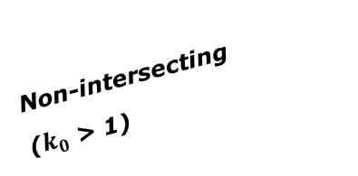
Changing projection axis to reduce distortion variation
Topographic surface
Grid distance = ground distance at many points
Projection
axis
Ellipsoid height of surface not constant:
h₁ ≠ h₂
h₂
Non-intersecting
($k_{0}$ > 1)
h₁
Only way to reduce variation in distortion is to change projection axis location.
IMPORANT: For large areas, there is no single defining ellipsoid height, h, for scaling the projection.
Ellipsoid surface

Slide 24
What changes for default designs?
Most zones will keep same extents and projection type
Possible changes in projection types and zone extents
  Single OM zone for FL peninsula (replaces 2 TM zones)
  Single OM zone for Hawaii (replaces 5 TM zones)
  Group RI, CT, MA into one zone (reduces number zones by 3)
  Include Guam and CNMI in a single TM zone
  Define Lambert Conformal Conic zone for American Samoa
  Redefine AK zones to better correspond to land use
  Add zone for Washington D.C.

Slide 25
Statewide and “layered” zones
Policy§III.A.2.
Limitations
  Max of TWO layers: Statewide and sub-zones
  If two layers, one MUST be statewide
  Minimum subzone dimension > 50 km
States often want statewide and small zones
  Statewide: Single geometry required for state GIS
  Sub-zones: Lower distortion for surveying/engineering
Accommodates state needs, but with restrictions
  Prevent poor design choices for statewide zones

Slide 26
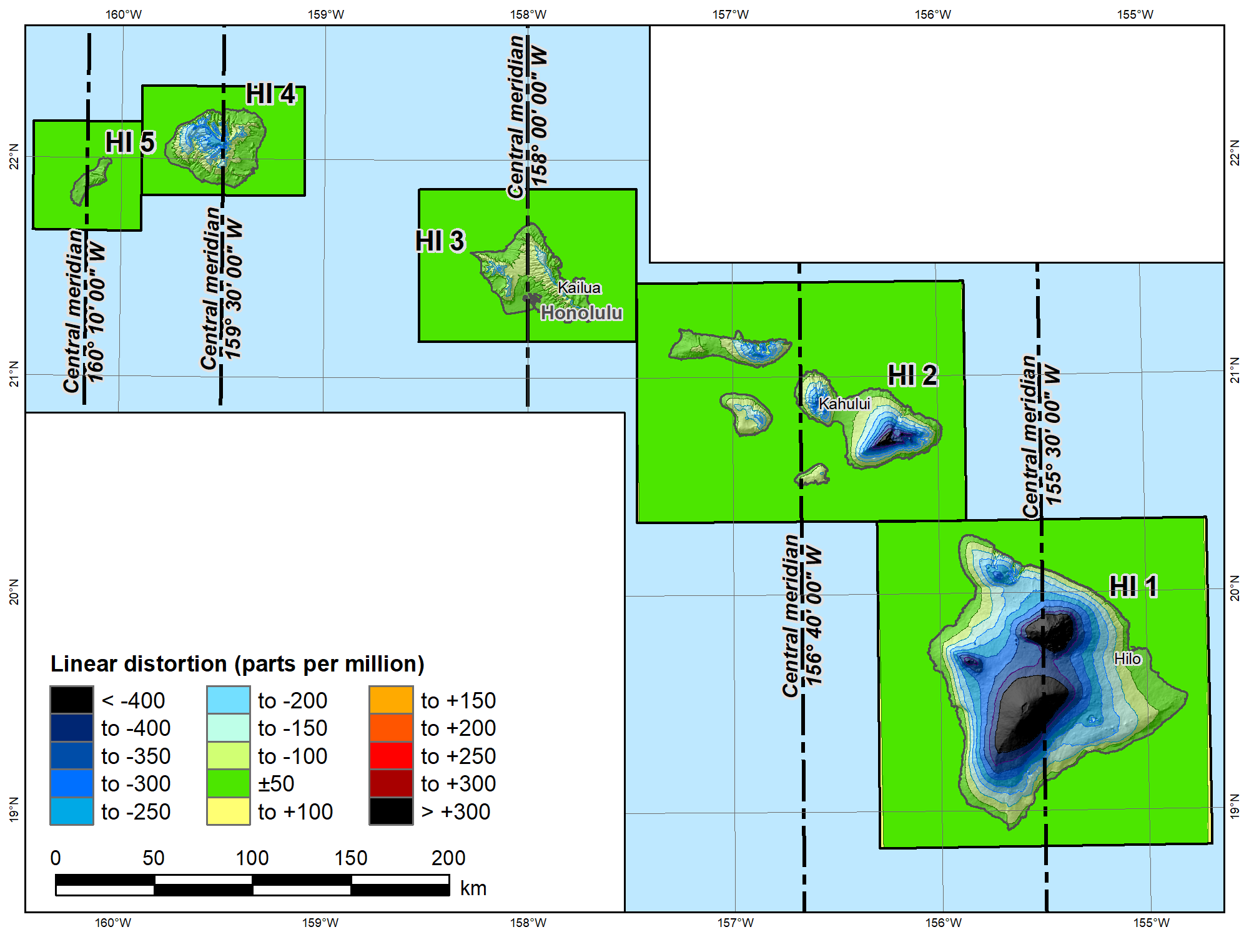
SPCS 83 Hawaii Zones 1 – 5
(all Transverse Mercator)
Topographic
ellipsoid height
(meters)
Min | 12
Max | 4188
Mean | 918
 |  | SPCS 83 HI
Scale |  | 1 to 0.99996667
 |  | Distortion (ppm)
Min |  | -690
Max |  | +29
Mean |  | -163

Slide 27
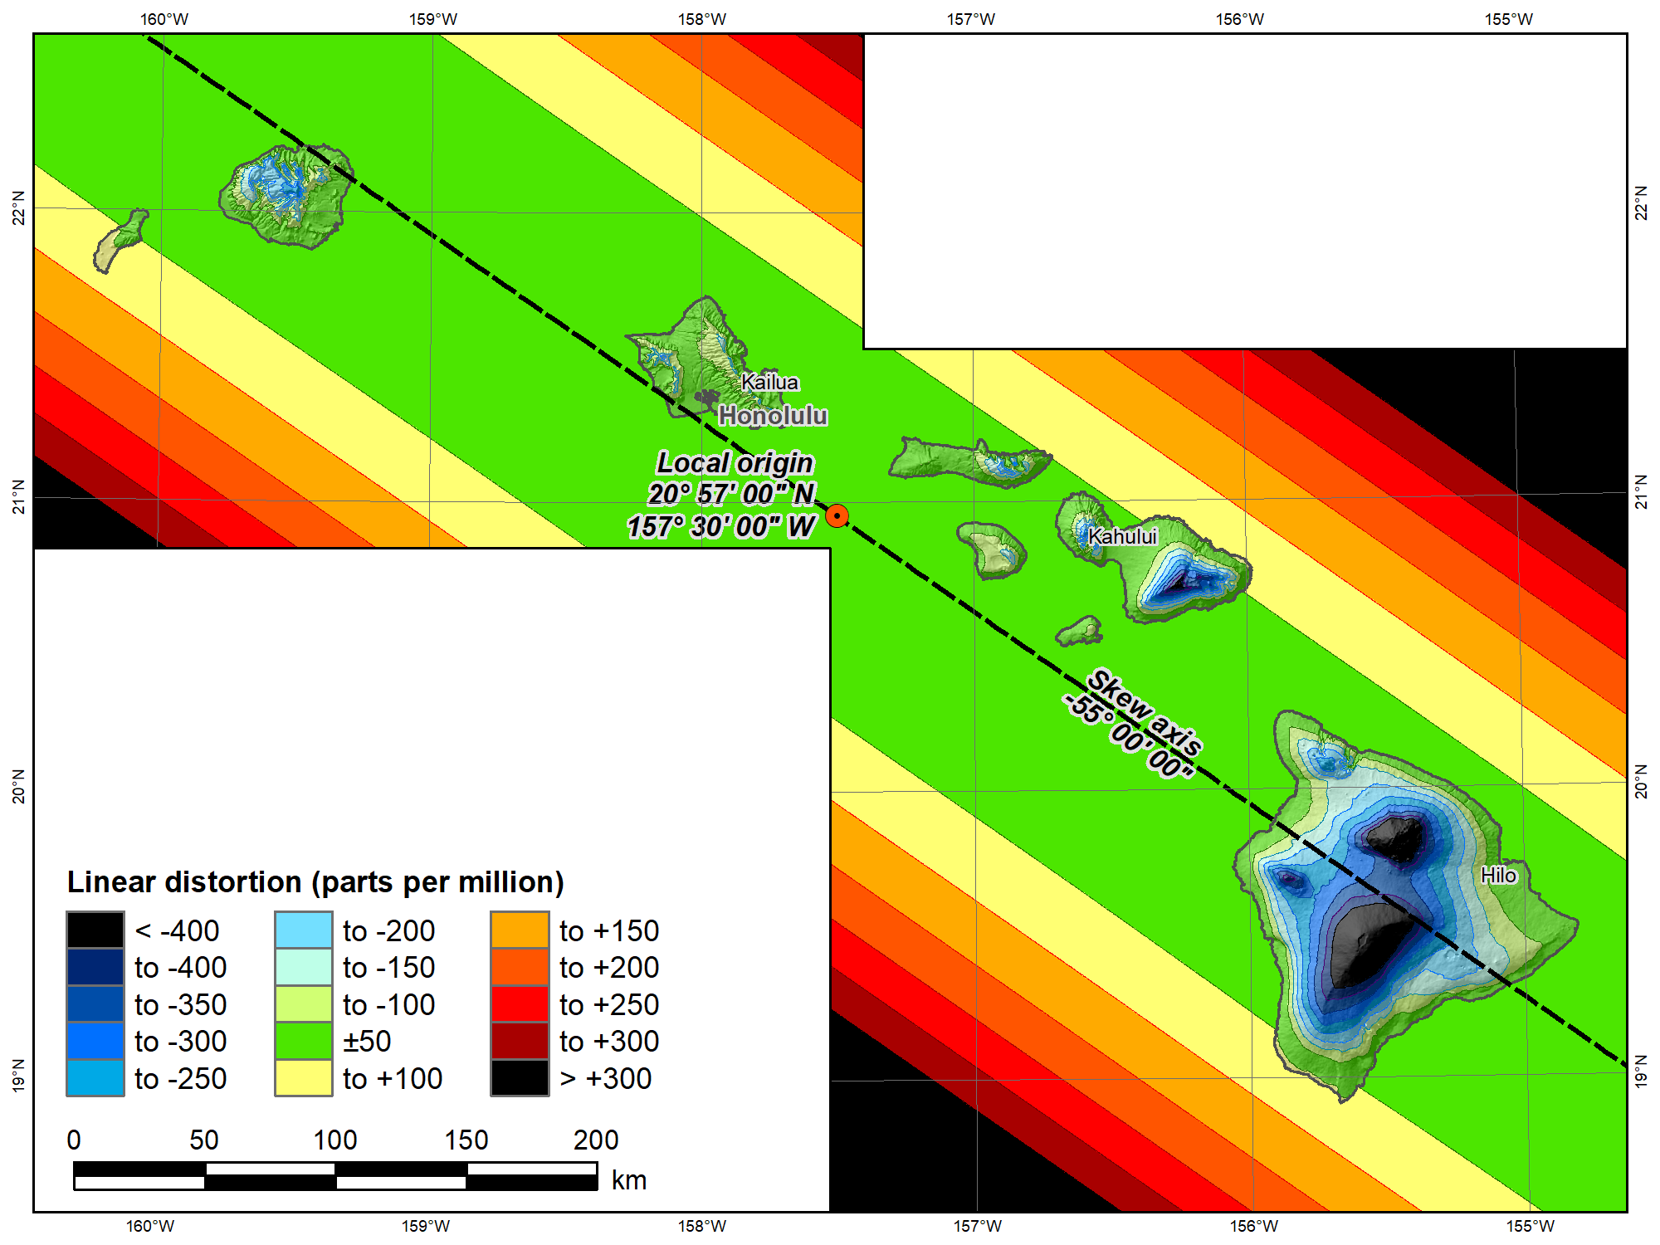
Single SPCS2022 Hawaii “default”
(Oblique Mercator)
Topographic
ellipsoid height
(meters)
Min | 12
Max | 4188
Mean | 918
 |  | SPCS 83 HI | SPCS2022
Scale |  | 1 to 0.99996667 | 1
 |  | Distortion (ppm)
Min |  | -690 | -652
Max |  | +29 | +160
Mean |  | -163 | -129
Change projection type and replace five zones with one

Slide 28
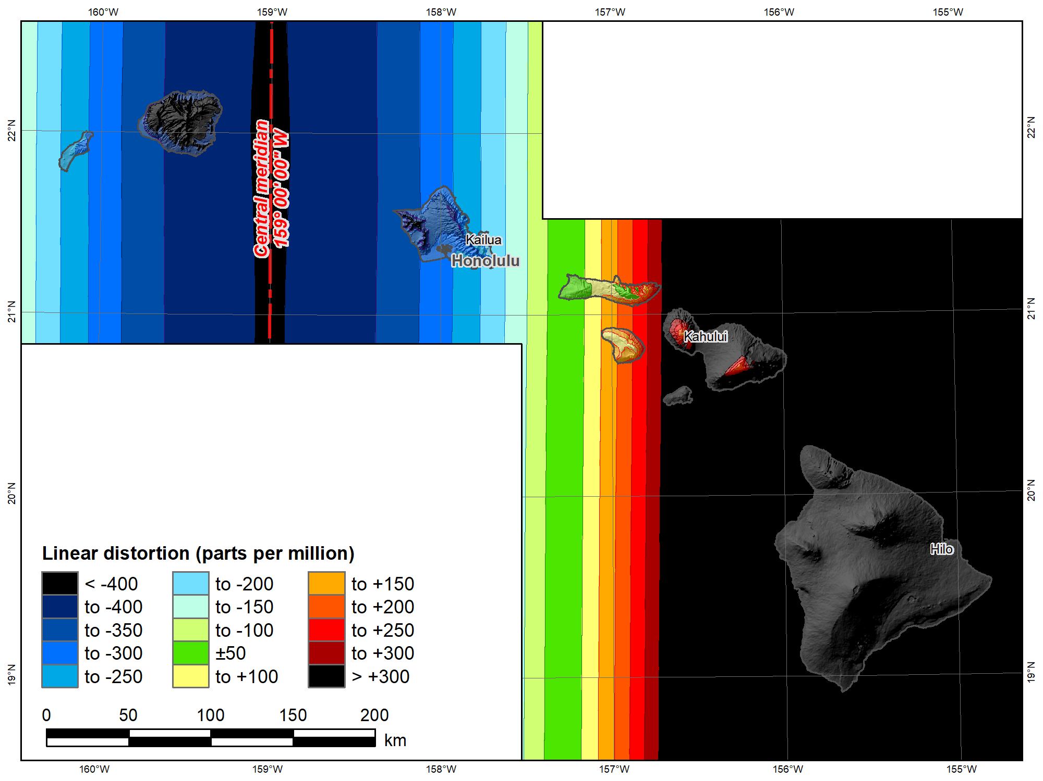
UTM 83
Zone 4 North
(Transverse Mercator)
Topographic
ellipsoid height
(meters)
Min | 12
Max | 4188
Mean | 918
 |  | UTM 83 4N | SPCS2022
Scale |  | 0.9996 | 1
 |  | Distortion (ppm)
Min |  | -613 | -652
Max |  | +1995 | +160
Mean |  | +659 | -129

Slide 29
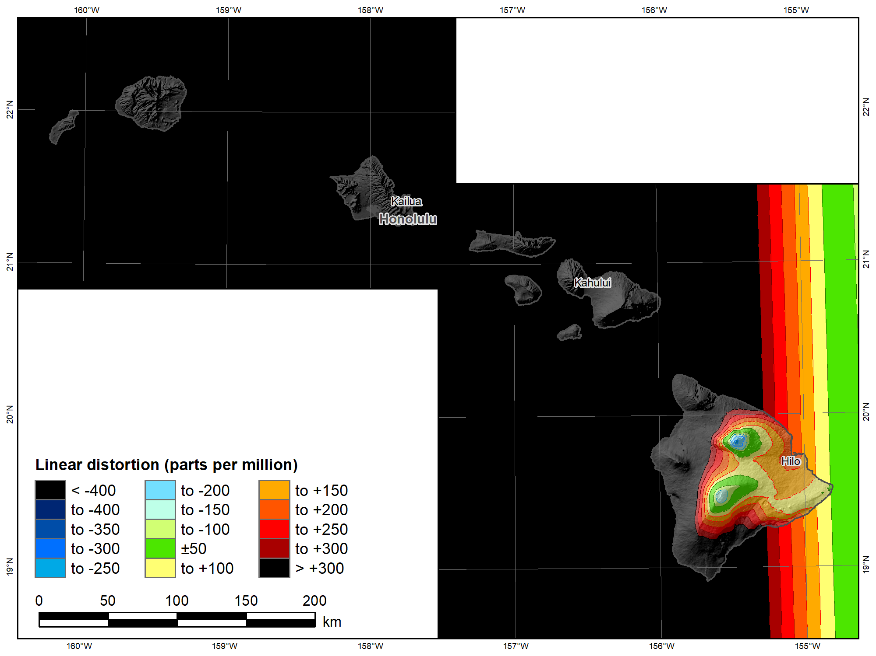
UTM 83
Zone 5 North
(Transverse Mercator)
Topographic
ellipsoid height
(meters)
Min | 12
Max | 4188
Mean | 918
 |  | UTM 83 5N | SPCS2022
Scale |  | 0.9996 | 1
 |  | Distortion (ppm)
Min |  | -234 | -652
Max |  | +6558 | +160
Mean |  | +1192 | -129

Slide 30
SPCS2022 Deadlines
Consensus input per SPCS2022 procedures
  Requests for designs done by NGS
  Proposals for designs by stakeholders
Submittal of approved designs
  Proposal must first be approved by NGS
  Designs must be complete for NGS to review
Forms are easy → hard part may be getting agreement
After deadlines→ changes to SPCS2022 (after 2022)
NGS.SPCS@noaa.gov
by March 31, 2020 for requests and proposals
by March 31, 2021 for submittal of approved designs
Form for requests
and proposals
Form for submitting stakeholder designs

Slide 31
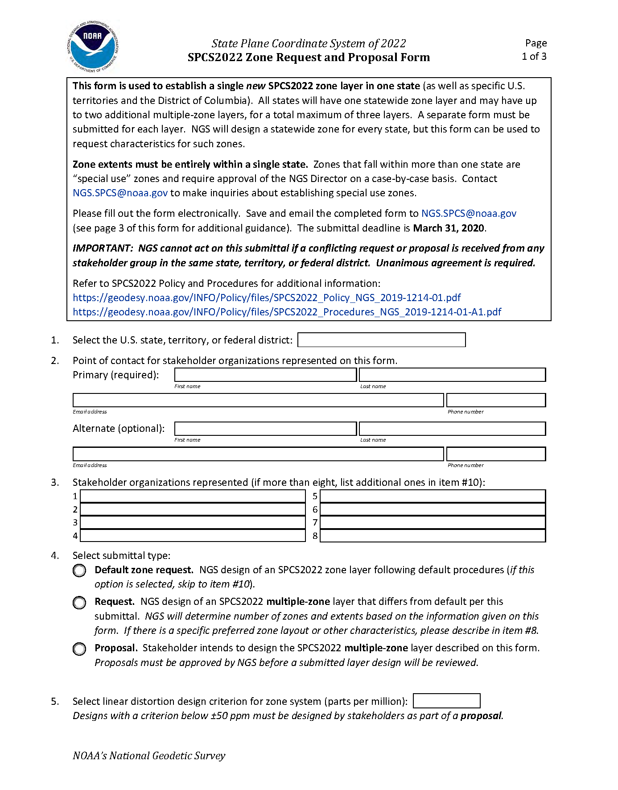
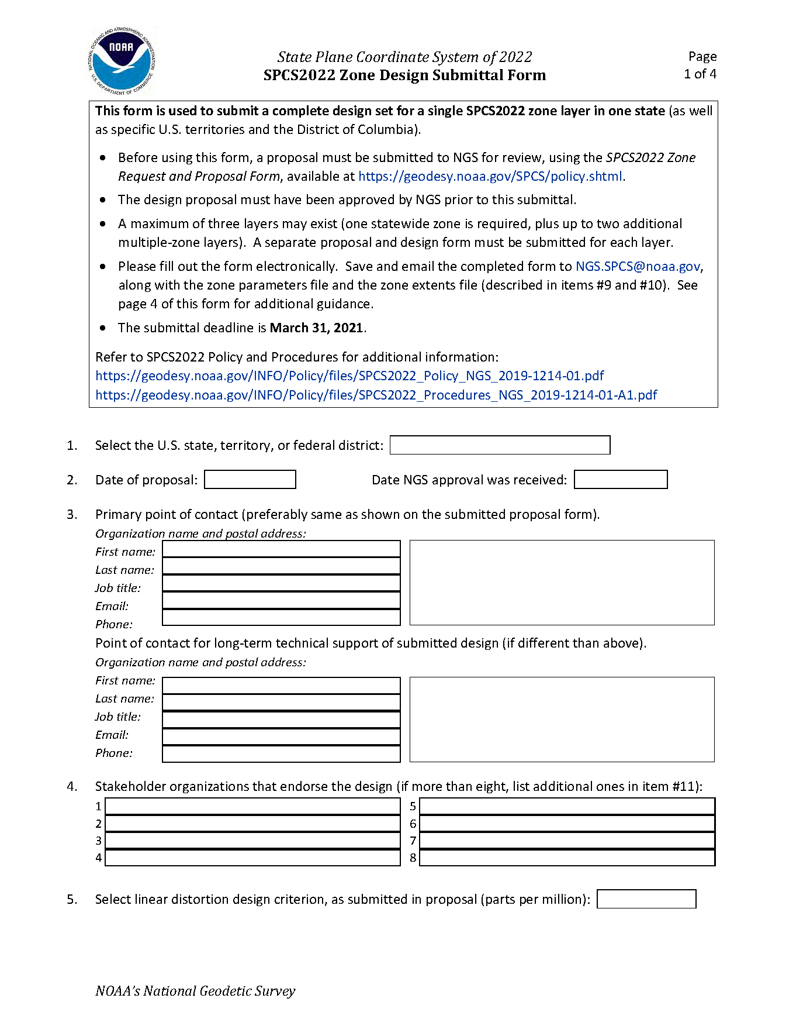
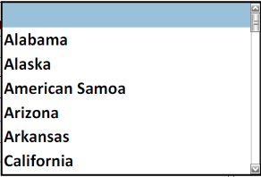
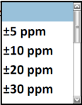
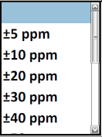
Request/Proposal Form
Design Submittal Form
Deadline:
March 31, 2020
Deadline:
March 31, 2021
NGS-approved proposal required

Slide 32
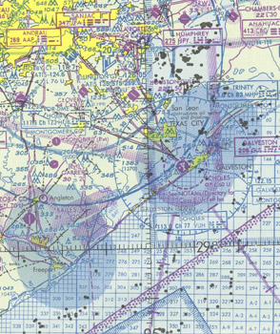
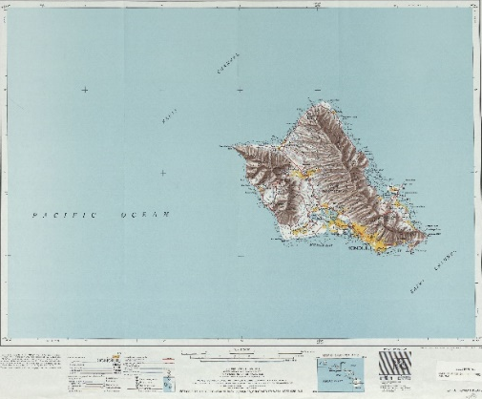
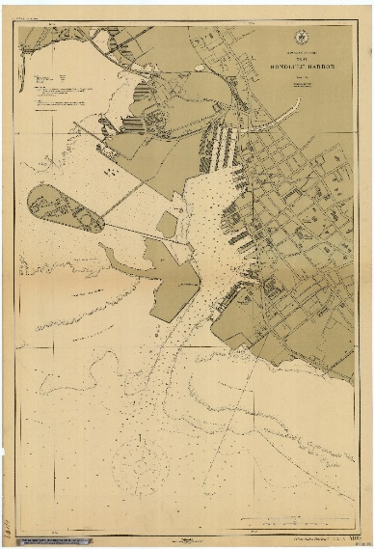
What to do with historic maps/charts?
Is the accuracy expected to be better than a few meters?
No
Yes
Stop. You won’t likely gain much by transforming
Do you have trusted metadata which puts the map/chart in the NSRS?
Yes
No
Stop. Transformation tools only work in the NSRS and only if you trust the metadata
Use NCAT to update the datums in 2022

Slide 33
X, Y, Z
φ, λ, h
NGS Coordinate Conversion
&
Transformation Tool
(NCAT)
2022
X, Y, Z
SPC
UTM
φ, λ, h
USSD
USNG
UTM
φ, λ, h
φ, λ, h
Old Hawaiian, Guam
NAD 83 (2011,PA11,MA11)
X, Y, Z
SPC
X, Y, Z
SPC
USNG
UTM
USNG
UTM
NAD 83 (NSRS2007)
φ, λ, h
NAD 83 (1986)
φ, λ, h
NAD 83 (FBN)
NAD 83 (HARN)
φ, λ, h
X, Y, Z
SPC
X, Y, Z
SPC
φ, λ, h
USNG
UTM
USNG
UTM
X, Y, Z
SPC
X, Y, Z
SPC
USNG
UTM
USNG
UTM

Slide 34
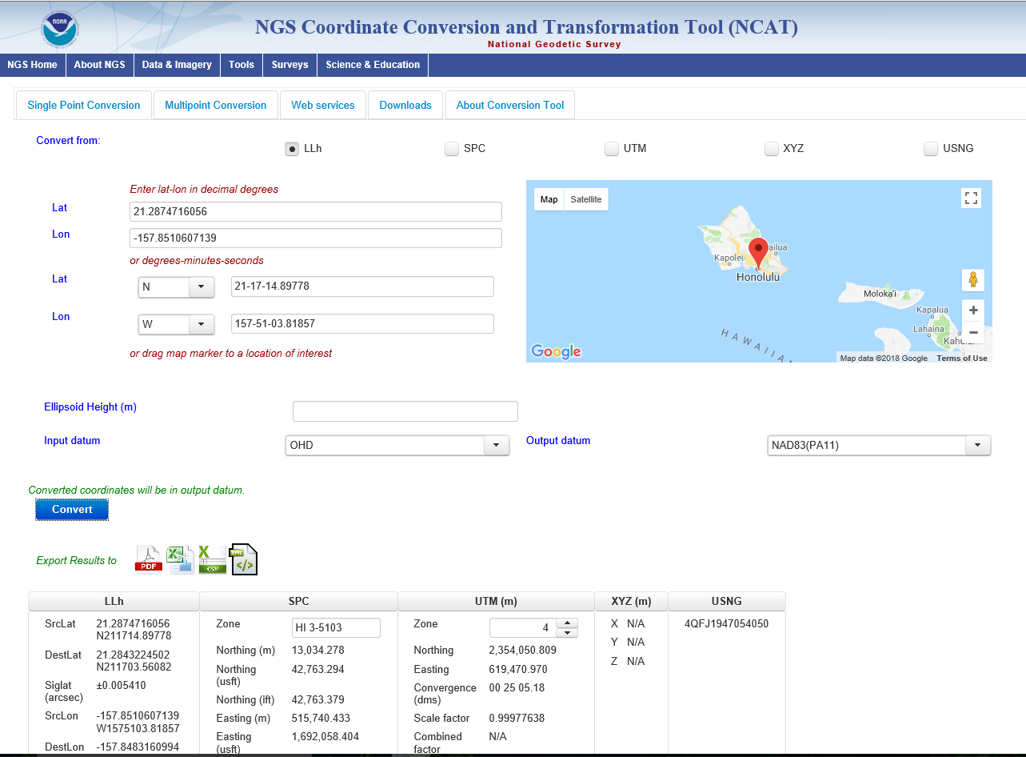
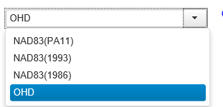
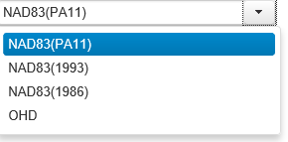

Slide 35
Q: When should I care?
A: When your accuracy needs are smaller than about 4 meters
Expected latitude/longitude changes:
  1-2 meters CONUS
  2+ meters Alaska
  3.5+ meters Hawaii
Expected (“MSL”) height changes:
  1-2 meters CONUS
  2+ meters Alaska
  Unclear Hawaii??
Plus, time-dependent changes to all of these at ~few cm/year

Slide 36
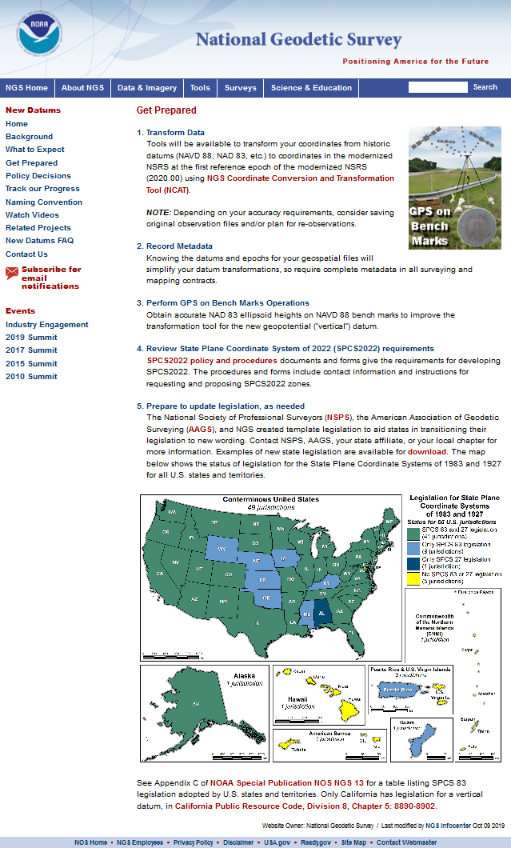
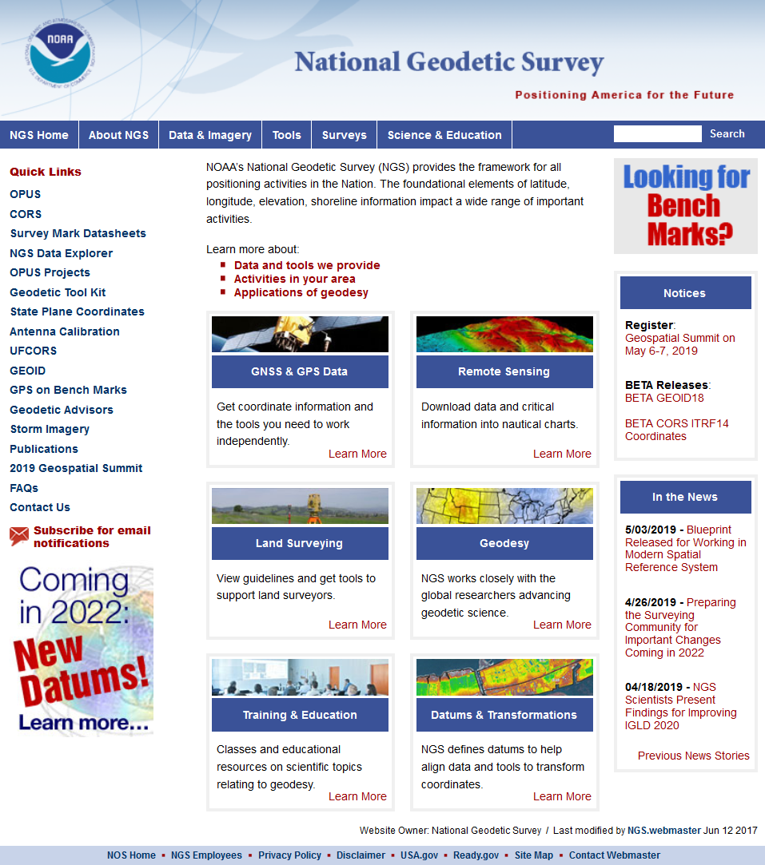
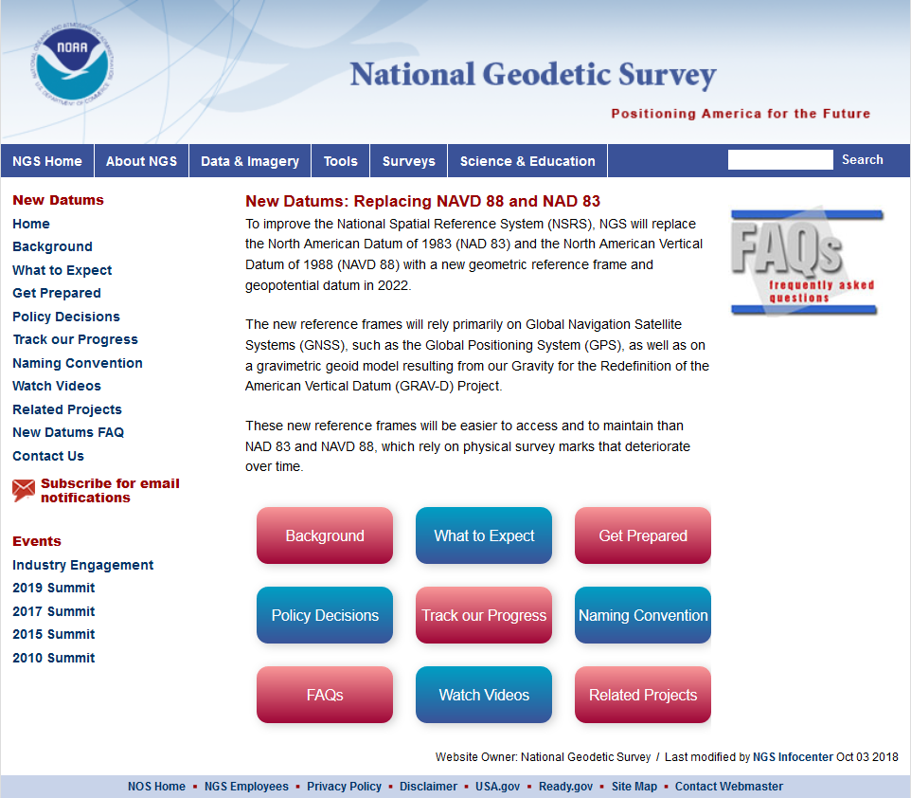

geodesy.noaa.gov

Slide 37
The Bottom Line
If you do geospatial work in the United States and its territories, and you work in the National Spatial Reference System, then every product you’ve ever made…
  every survey
  every map
  every lidar point cloud
  every image
  every DEM
… WILL have NEW coordinates in 2022.

Slide 38
Asked Questions
2022 Datum/ State Plane Zones:
* New central meridian
* Conversion from UTM Zones 4&5 to new single state plane zone
* Will the counties be converting?
* Will surveyors will be converting and adapting as well?
* When will the decision to go to the single zone will be made?
* Is it possible that Hawaii will have both a single State Plane Zone, but can also keep the 4 separate zones, as is the case in several other states?

Slide 39
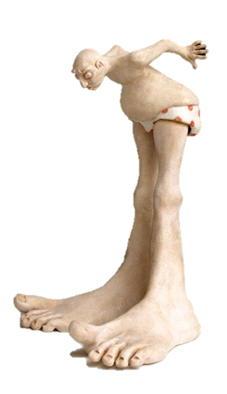
10 Minute Break
Next
Putting the best “foot” forward

Slide 40

Putting our best “foot” forward
The Right & Lawful Rood
A rod is ~ 16.5 feet
From geometry book of Jacob Köbel (1460-1533), 1608 edition
Notes:
Thanks to Harry Nelson of Maine DOT for making me aware of this wonderful engraving!
Shows 16 men randomly selected after church service to determine a “rood” (also known as “rod”, “perch”, or “pole”). It’s a unit that was commonly used in the past for measuring land in Europe and America.
The “rood” was determined as the length of their left feet, aligned toe to heel as they stood in a line.
Its length varied a lot, from 12 to 24 feet, depending on time and location. A rod is usually assumed to be 16.5 feet, but this is not always the case.
This is more than just a fun slide; it is important and relevant to this presentation.
The rood being determined here is specifically for the community that goes to this church. It is “their” rood.
A rood in another community (or determined at another time with other men) would most certainly be different.
It is not a national standard, not a state standard, not a county standard. It is at best a town standard, and may not even be that.
Although convenient and in some ways representative, the lack of standardization would later lead to problems. Hence this presentation…

Slide 41




Who is responsible for standards?
Today:
National Institute of Standards and Technology
Notes:
Today, the National Institute of Standards and Technology (NIST) is responsible for defining and establishing standards. It is within their authority.
NIST is a bureau of the Department of Commerce (DOC)
The National Oceanic and Atmospheric Administration (NOAA) is also a bureau of DOC.
The National Geodetic Survey (NGS) is a program office in NOAA. It’s actually within the National Ocean Service (NOS) in NOAA.
It may seem odd to show NGS here along with NIST, but there is a reason for it, as you will soon see.

Slide 42
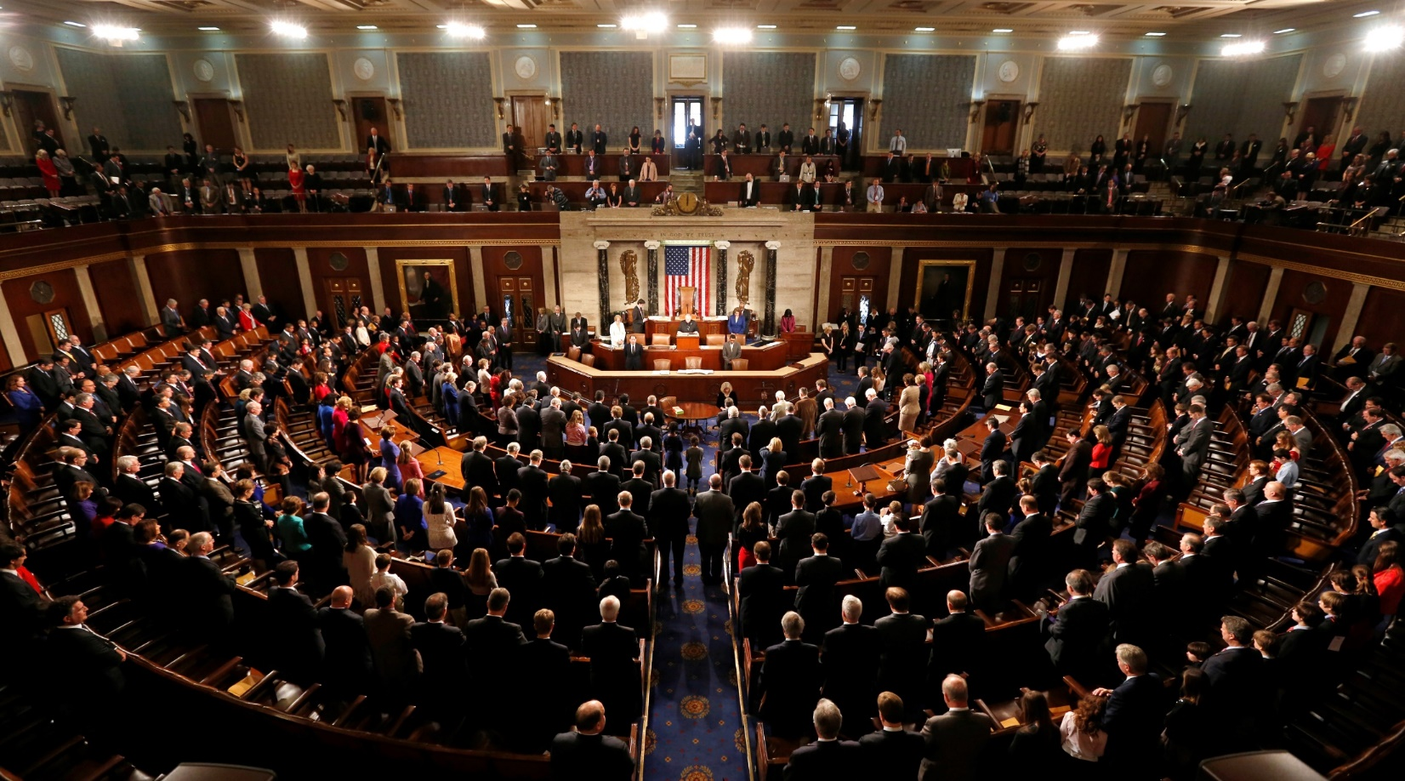
Congress is the Authority
Notes:
The ultimate authority on standards of weights and measures is the U.S. Congress.

Slide 43
Congress is the Authority
Per the U.S. Constitution
(Article I, Section 8, Clause 5)
“The Congress shall have
Power … To coin Money …
and fix the Standard
of Weights and Measures”
Why? To avoid the “toothbrush problem”
Notes:
The authority of Congress is given in the U.S. Constitution, Article I, Section 8, Clause 5.
Congress delegated its power to the Office of Weights and Measures in the Department of the Treasury.
NBS then got this authority as the successor to the Weights and Measures, and NBS became part of DOC.
Why was something like standards of weights and measures so important that it was specifically listed as a congressional power in the Constitution?
Because standards for weights and measures are tightly connected to commerce, including coining of money. We’re going to come back to this near the end of the presentation.
In short, it was to avoid the “toothbrush problem”…

Slide 44

The trouble with standards…
Without uniformity, standards are useless
Image from beyondplm.com
Notes:
It does not good to have a bunch of conflicting standards. That’s the same as having no standards at all.

Slide 45

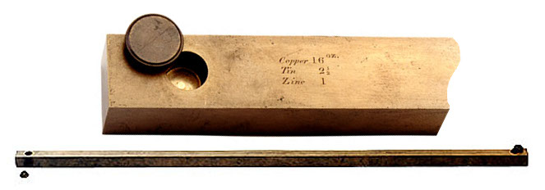
Hassler and the Empire
Efforts to make and measures consistent with the British Imperial system.
1815 - Brings “Troughton Bar” from England
1832 - Submits report to Congress “Adoption of Uniform Standards”
1834 - House of Parliament in England burned down, irreparably damaging
official Imperial Yard
1855 - A new Imperial Yard was created and two copies sent to the U.S.
which different lengths
0.000 073 foot (0.022 mm) shorter than Troughton scale (24 ppm)

Slide 46

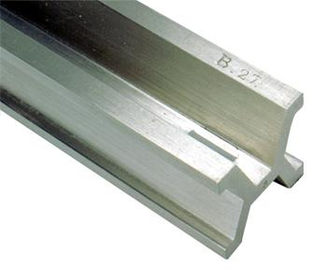
Going metric, in fits and starts
1866 - Congress legalized use of the metric system for commerce in the U.S.
1875 - U.S. signs “Treaty of the Meter” of “Metric Convention” with 16 other nations.
1890 - Copies of the international meter were made, with none being the “official”
version.
Different length!

Slide 47

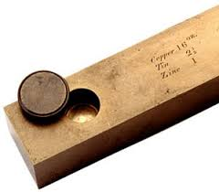

Out of chaos, order
1893
The Mendenhall Order
Thomas Mendenhall
Superintendent C&GS and Office of Weights & Measures (1889-1894)
Embraced meter
Abandoned British Imperial Yard
Declared foot defined by meter:
1 foot = 1200/3937 meter
Provided tables of conversions
e.g., Gunter’s chain = 20.1168 m
66 ift EXACTLY
65.999868 sft
The U.S. officially became metric
Notes:
The Mendenhall Order (1893): When the U.S. officially became metric.
Officially adopted meter as basis of length, where 1 foot = 1200/3937 meter (per 1866 act of Congress), and with meter represented by Meter Bars No. 21 and 27.
Completely abandoned British Imperial Yard as basis for length (as represented by Bronze Bar No. 11).
Declared in Appendix 6 of C&GS Bulletin No. 26, including conversion tables.
Interesting to note that conversion showed 1 Gunter’s chain = 20.1168 m
That is EXACTLY 66 ift (vs. 65.999868 sft)
This is just a coincidence due to rounding, but it shows that for the precision of the chain, the distinction between the ift and sft is immaterial…

Slide 48
Kicking the can (Federal Register)
1959
“Any data expressed in feet derived from and published as a result of geodetic surveys within the United States will continue to bear the following relationship as defined in 1893:
1 foot = 1200/3937 meter
The foot unit defined by this equation shall be referred to as the U.S. Survey Foot and it shall continue to be used, for the purpose given herein, until such a time as it becomes desirable and expedient to readjust the basic geodetic survey networks in the United States, after which the ratio of a yard, equal to 0.9144 meter, shall apply.”
https://geodesy.noaa.gov/PUBS_LIB/FedRegister/FRdoc59-5442.pdf
Signed by NBS and C&GS directors, approved by Secretary of Commerce, June 25, 1959
Notes:
Federal Register Notice (1959) establishing ift and (temporary) sft
Official adoption of ift (1 ft = 0.3048 m) nationwide.
Temporary exception granted for geodetic surveys (including State Plane coordinates), to accommodate C&GS.
Mandates that ift shall be adopted after readjustment of U.S. geodetic network. This is not a “recommendation” or a “suggestion.” At the time this was published, “shall” was used in legal documents as mandatory (nowadays the usage of “shall” as mandatory is discouraged in legal documents).
Co-issued and signed by NBS and C&GS directors.
This FRN delayed full adoption of the ift, and promoted continued use of the sft for all surveying (not just geodetic surveys), and it is how we got into the situation we are in today.

Slide 49
Epilogue for an erstwhile foot?
The “old” foot defined in 1893 (actually 1866)
Foot officially redefined in 1959
  Old one named “U.S. survey foot” at that time
  Intended as temporary solution
  Supposed to switch to new foot with readjustment of “basic geodetic survey networks”
Kicked can down road in 1959, again in 1986
  Not done for NAD 27 → NAD 83 in 1986
  NGS sidestepped issue by going metric in 1977
What do we do now?
  Another chance with NAD 83 → NSRS2022

Slide 50
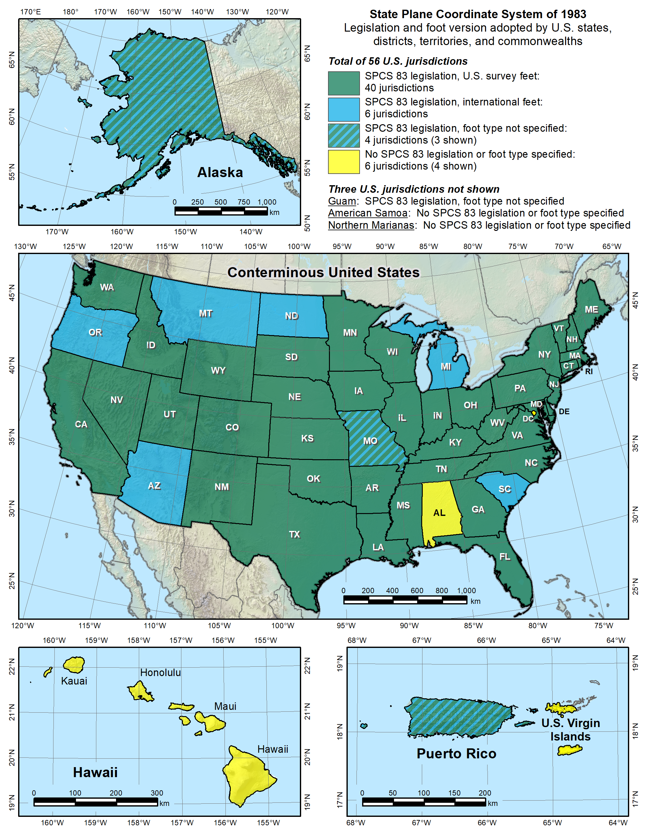

Notes:
Despite the mandate of the 1959 FRN, and the change to a new datum in 1986, NGS allowed states to choose whether they want State Plane coordinates in feet, including which type of foot.
Over time various states have taken actions to select the foot they want to use. Of the 40 states that have selected the sft, 28 have done so in statute, and 12 have done so by working with NGS to issue an FRN (the latest being in 2009, for Utah). So the situation with the 40 “green” states is more complicated than it appears.
Simply put, this is again chaos, just as it was before the Mendenhall Order of 1893. This is exactly the type of situation our five heroes wanted to avoid, having different standards of measure for different parts of the U.S. It is far worse than this map indicates, since jurisdictions within a state use a different foot than on this map. For example, Hawaii shows no foot selection (not even SPCS 83 legislation), yet it uses sft for most areas but ift on military bases. Arizona is shown as an ift state, yet the National Park Service uses sft within Arizona. It is a complete mess. There is no way for me to know for sure, but it is my opinion that our heroes would be spinning in their graves if they saw this.
Addendum: Some surveyors look at the CONUS map and ask why NGS is proposing the ift rather than the sft, since more states have officially selected the sft for SPCS 83 (40 vs. 6). It seems a reasonable question, but it is flawed, for the following reasons:
Minority vs. majority. This is not an issue of a minority overruling a majority. Although most states have adopted the sft (for SPCS 83), it’s important to recognize that surveying and mapping represents only a tiny fraction of overall economic activity in the U.S. Other major parts of the U.S. economy make use of the ift. For example, one of the reasons the ift was adopted in 1959 was for standardizing gauge blocks (the primary means of length standardization used by industry). So surveying is actually a small part of this issue. Because of that, there is essentially no chance that NIST will go back to the sft definition for the entire U.S. If there is going to be one foot, it will certainly be 1 ft = 0.3048 m (exact).
Uniformity. For standards to be useful, they must be uniform. That is why Congress is empowered by the U.S. Constitution to establish standards of weights and measures. Having two concurrent nearly identical definitions of the foot is inconsistent with the very idea of standards. And it is bad for business (i.e., commerce). Keeping the sft for surveying and mapping while using the ift for everything else would perpetuate the inconsistency.
Original intent. In the 1959 FRN that announced nationwide adoption of the ift, the previous foot was named the sft with the intent that it be temporary. It was an accommodation by NBS to C&GS, exclusively for geodetic work. The 1959 FRN mandated that the ift be adopted after readjustment of the U.S. geodetic networks. That occurred in 1986 with the change from NAD 27 to NAD 83. So use of the sft was supposed to end at that time, but it did not. It appears the main reason is that NGS side-stepped the issue by going metric in 1977, perhaps in the hope that the entire nation would go metric. Instead the “temporary” sft became embedded as part of how SPCS 83 is used (but not in how SPCS 83 is defined – the definitions for every zone are metric).
SPCS 83 vs. SPCS2022. In those states where the sft is specified (by state statute or FRN), it is associated with SPCS 83. Such specifications will not apply for SPCS2022. A state could legislate sft for SPCS2022, but if NIST mandates use of the ift, that would likely override state statute, per the U.S. Constitution.
Authority. Only NIST has the authority to deprecate the sft, not NGS. In the end, the fate of the sft will be up to NIST. The reason NGS is involved is that the existence of the sft is due entirely to NIST accommodating NGS in 1959. Because of that, NGS bears responsibility in trying to resolve the issue, as we should have done in 1986, and NGS will work with NIST to that end. If the decision is to deprecate the sft after 2022, it will be announced in an FRN, and NGS will also take other steps to inform our customers. But NGS will continue to support the sft for legacy applications in SPCS 83 and 27 in our products and services.

Slide 51
Why make the change?
That was original intent (60 years ago!)
Two “feet” is inefficient and causes confusion
  Leads to errors that cost money
  Absurd to have “same” unit that differs by 2 ppm
  Defeats purpose of having a length standard
Only recognized in part of U.S.
NGS software can support backward-compatibility
Now is the time
  Many changes already being made for 2022
  Change in foot trivial compared to other changes
  U.S. survey foot problems will never go way if not addressed
Notes:
Continuing with why we should make the change:
The sft is not recognized in the entire U.S. Only in parts of the U.S. And even for states where the ift or sft is specified, there are internal exceptions (a few of which I have already mentioned).
NGS can make the transition easier by automatically supporting backward-compatibility in our software. That way you would get sft for all SPCS 27 zones, and also for SPCS 83 in the 40 states that have specified the sft for SPCS 83.
To repeat: Now is the time. Otherwise this problem will never go away (unless the U.S. goes completely metric).

Slide 52
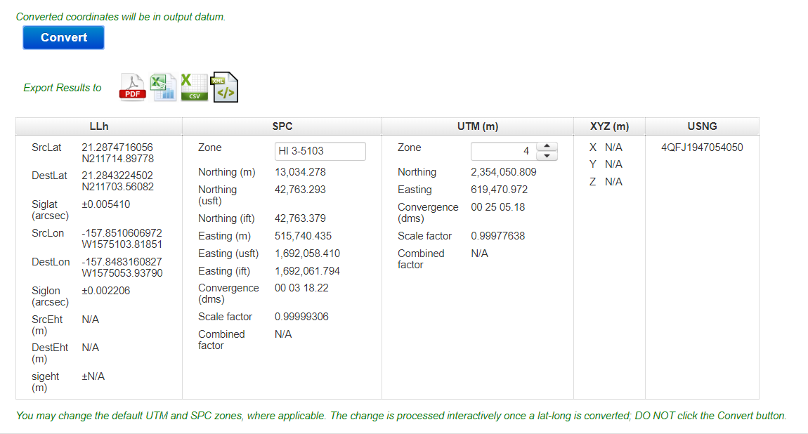
0.08ft
3.39ft

Slide 53
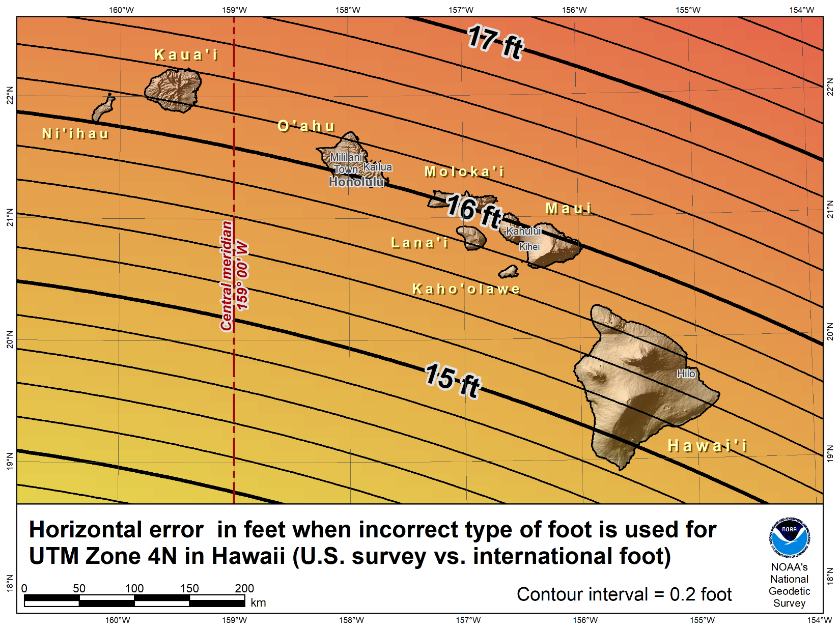

Slide 54



Almost Finished …
NGS created problem, will help fix it
  Fully support backward compatibility
  Will make simple and painless as possible
  Foot change minor compared to other 2022 changes
  Contact us at NGS.Feedback@noaa.gov
This is about the future
  Remember our heroes and their hard-won victories…
Notes:
In closing, I want to reiterate that NGS essentially created this problem, and now we want to help fix it. Yes, we are coming at this some 30+ years late, but there is no better time to do this than when we are updating the entire NSRS. A change in the foot definition will be a minor part of the overall changes that will occur when we make the transition to a modernized NSRS in 2022. NGS will do everything we can to make a foot change – and all the other 2022 changes – as simple and painless as possible. Remember, the idea here is not change for its own sake, but change to make things better. And these changes will make things better.
I encourage you to provide questions and comments to NGS.Feedback@noaa.gov. If this change for the foot goes forward, there will also be opportunities for comments as part of issuing an FRN.
I remind you, again, that this is about the future, not the past. The past will always exist and will not change. But the future is something we can change, and make better. Please remember our heroes, and the incredible work they put into establishing standards for weights and measures. Their eyes were also on the future, and we are the beneficiaries of their vision.
For those of you who are surveyors (as I am), this is more than about how you practice surveying today, wherever you may work, and whatever type of surveying you do. For those who want to retain the U.S. survey foot, I implore you to please consider the larger picture, and the future. That future will be inherited by the young surveyors, GIS professionals, and all other U.S. citizens. We should strive to do well by them, and for them.

Slide 55
How can you prepare?
Procedures and Workflows:
Analyze current procedures and workflows
Create plans for adjusting future data collection, including contract language
Data:
Maintain raw data collected today for transformations to the new datums in the future
Ensure proper metadata for current data and planned data collection to ensure the proper transformations will be used in the future (datum, foot)
Share information with NGS so we can understand agency challenges in converting current data to new datums

Slide 56
geodesy.noaa.gov

Slide 57
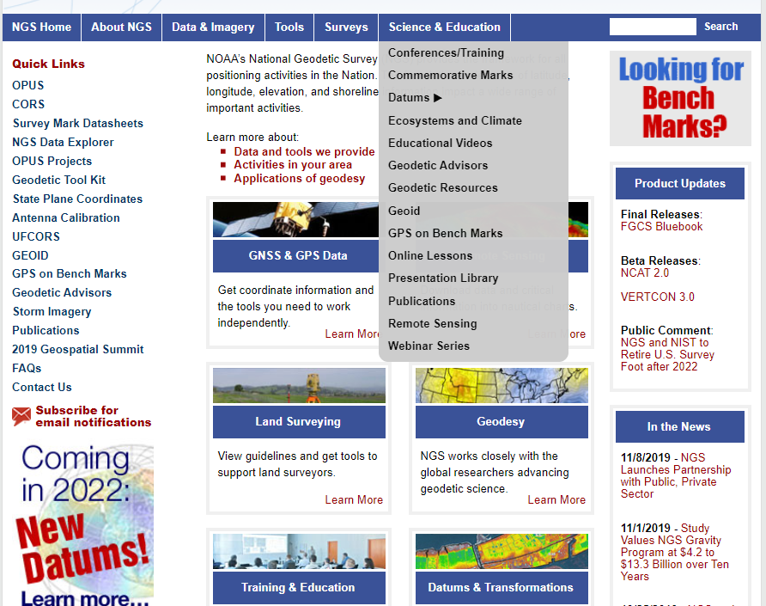

Slide 58
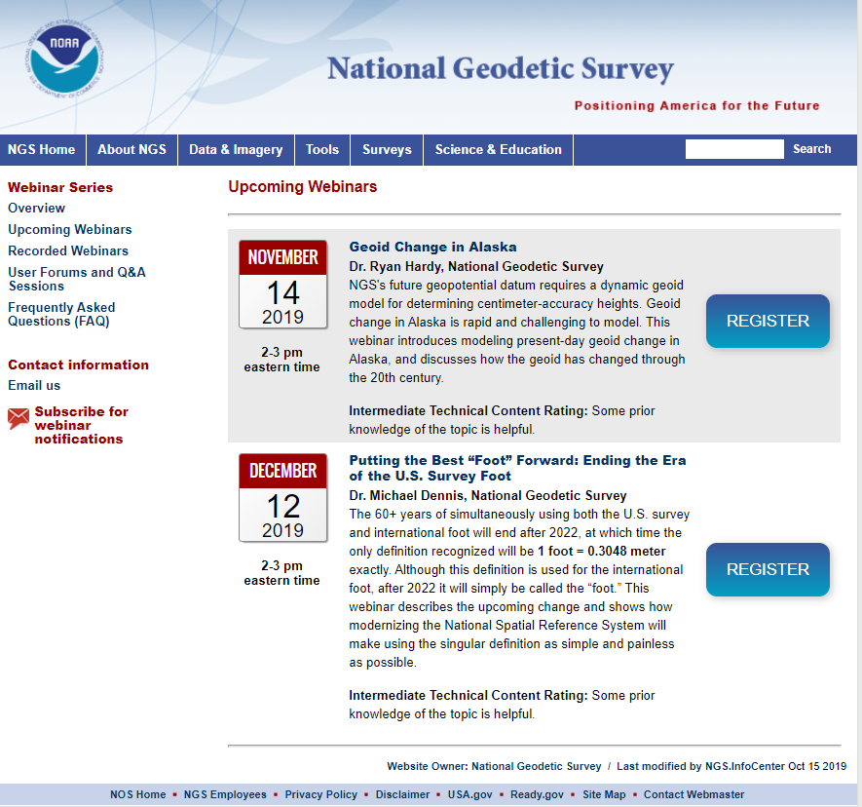
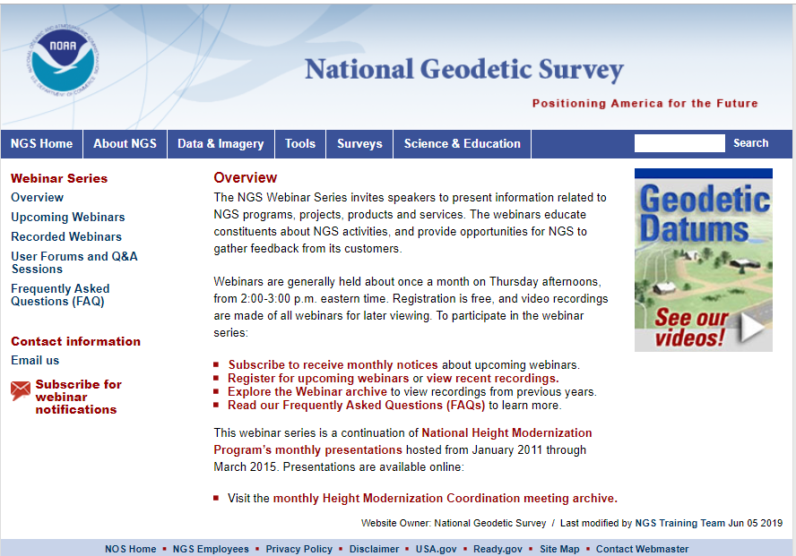

Slide 59

HLSA 2020 Conference
March 5 & 6, 2020
Michael Dennis will speaking on:
1. 2022 State Plane Coordinates System (SPCS)
2. Meet with HIDOT, HIGICC, HLSA to answer questions SPCS and “Foot Issue”

Slide 60
Asked Questions
2022 Datum/ State Plane Zones:
* New central meridian
* Conversion from UTM Zones 4&5 to new single state plane zone
* Will the counties be converting?
* Will surveyors will be converting and adapting as well?
* When will the decision to go to the single zone will be made?
* Is it possible that Hawaii will have both a single State Plane Zone, but can also keep the 4 separate zones, as is the case in several other states?
U.S. Survey Feet vs. International Survey Feet:
* Conversion of map coordinates from meters or latitude/longitude to feet
* Conversion of GPS coordinates to map units

Slide 61
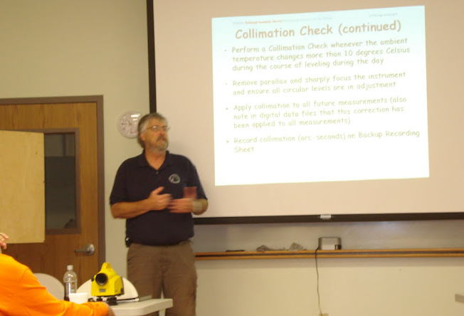
Mahalo
Edward E. Carlson
National Geodetic Survey
808-725-5255
ed.carlson@noaa.gov

